Slide 1
150318 pMHC competition
Cells: C57BL/6 fibroblasts: 2 wells containing 10⁵ cells / 3 ml / well in 6W plates
Transfections: V-ASN, V-LSL or V-SSL + mCh-SSL
Detection: 1C3 FabMab + RAM-IGg1-BV421 @1:500
E10 or 2E1 Fabs + GAH-IgG (H+L)-AF647 @1:200
Aims:
Can competition between peptides be observed?
Hierarchy of competition
Test double labelling
Check plasmid DNA via transfection efficiency
Compare RAM-BV421 and GAM-AF647 using pCMV-SIINFEKL + Mab D1

Slide 2
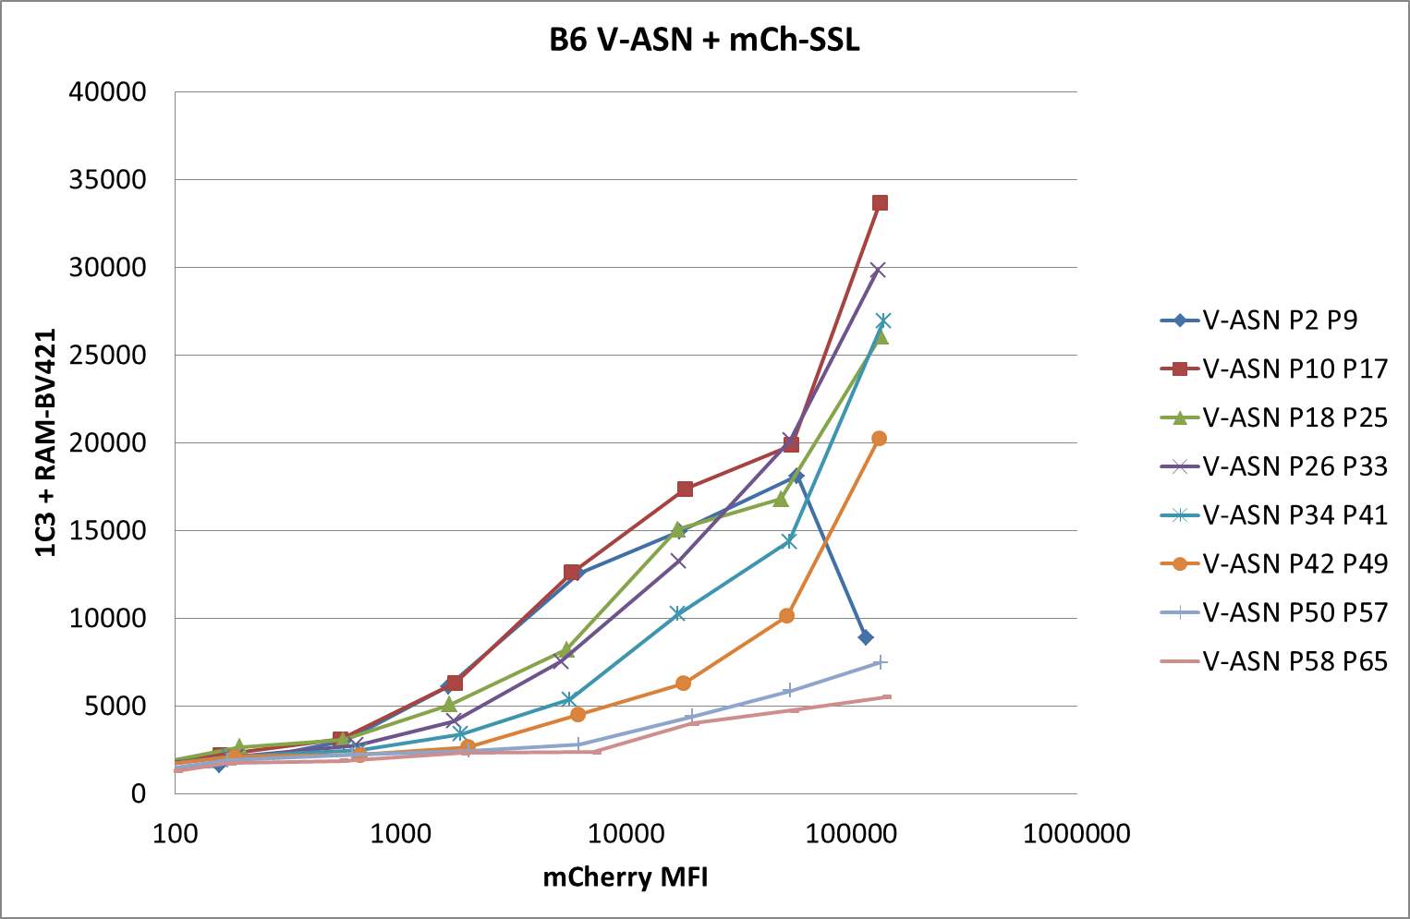
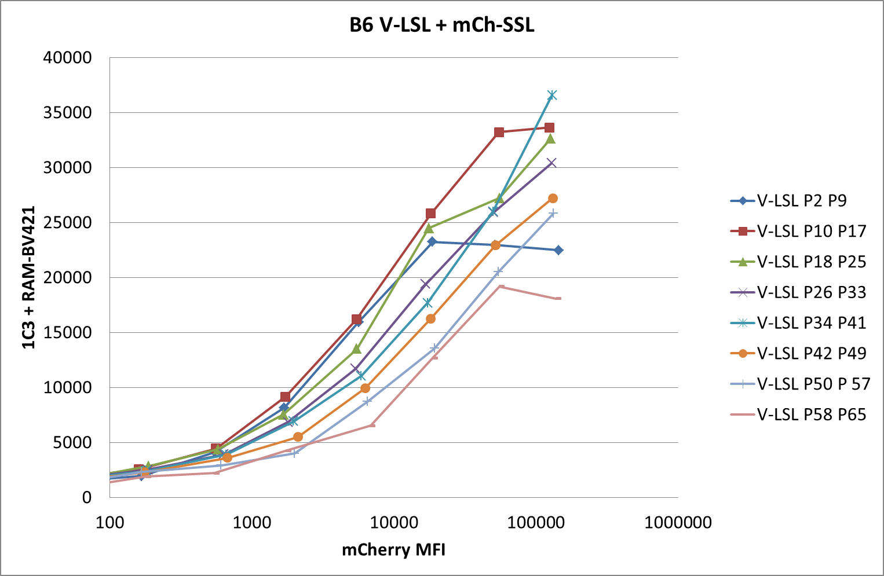
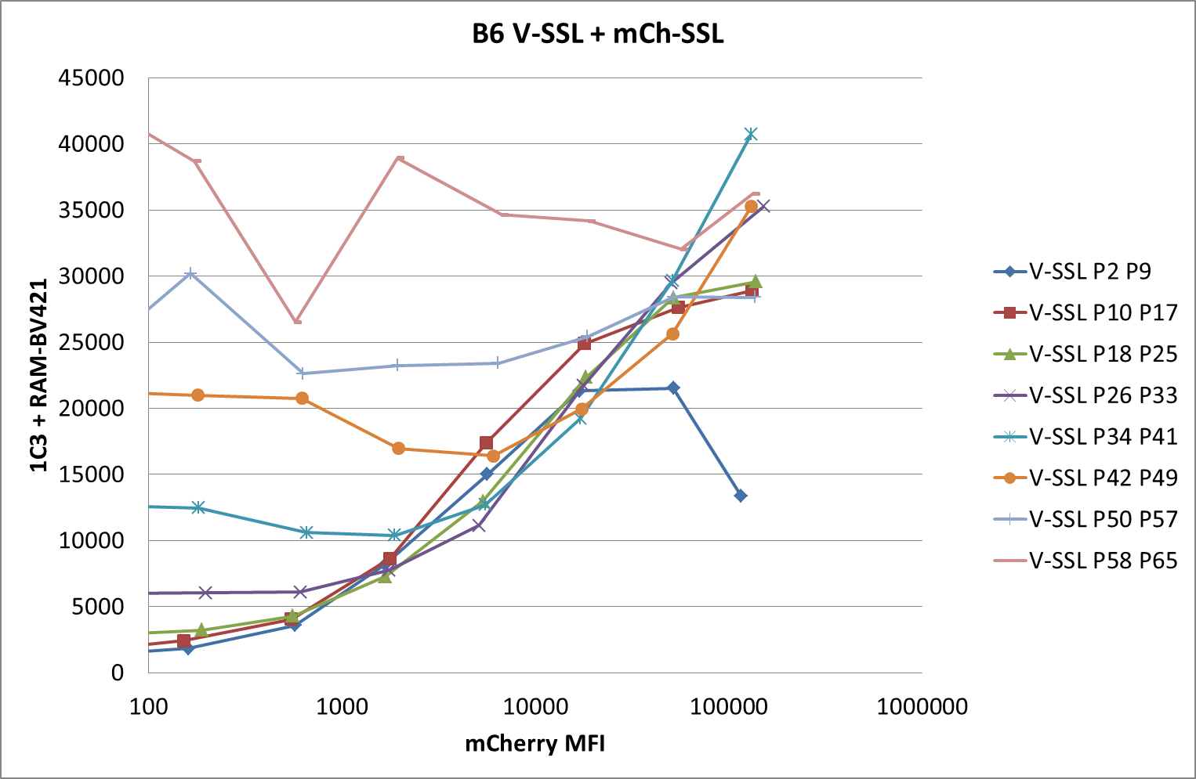
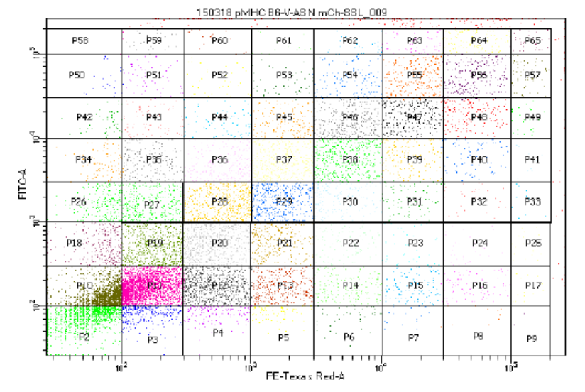
150318 pMHC competition
Notes:
SSL surface presentation is inhibited with increasing expression of ASN and LSL.
ASN competition is stronger than LSL. This is surprising as by BFA decay ASN showed faster off-rate than LSL. This needs further investigations:
repeat the experiment with the opposite constructs: V-SSL + mCh-ASN and mCh-LSL
Quantitate transcription levels of ASN and LSL to make sure we compare similar conditions
Revisit data from Mark/Tony on SIINFEKL BFA decay at different temperatures and pH (see PNAS paper for IFNg treatment and Mark’s thesis)
Add SD

Slide 3
Results:
Competition between peptides can be observed.
Hierarchy of competition: competition stronger with ASN
Test double labelling: GAH-AF647 cross-reacts with 1C3 FAbMab!!!
Check plasmid DNA via transfection efficiency
V-ASN 56%
V-LSL 49%
V-SSL 54%
mCh-SSL 56%
Compare RAM-BV421 and GAM-AF647 using pCMV-SIINFEKL + Mab D1:
GAM-AF647: 35,566 (P3) – 371 (P1) = 35,195 More sensitive
RAM-BV421: 23,184 (P2) – 1504 (P1) = 21,680

Slide 4
150325 pMHC competition
Cells: C57BL/6 fibroblasts: 2 wells containing 10⁵ cells / 3 ml / well in 6W plates
Transfections: V-ASN, V-LSL or V-SSL + mCh-SSL
Detection: 1C3 FabMab + RAM-IGg1-BV421 @1:500
E10 or 2E1 Fabs + GAH-IgG (H+L)-AF647 @1:200
Aims:
Confirm competition using 1C3 FabMab + RAM-BV421 on its own
Staining with second Fab in parallel
Compare transfection efficiencies in 6W plates and in 10 cm P.d.
Compare RAM-BV421 and GAM-AF647 using V-SSL transfected cells + 1C3 FabMab

Slide 5
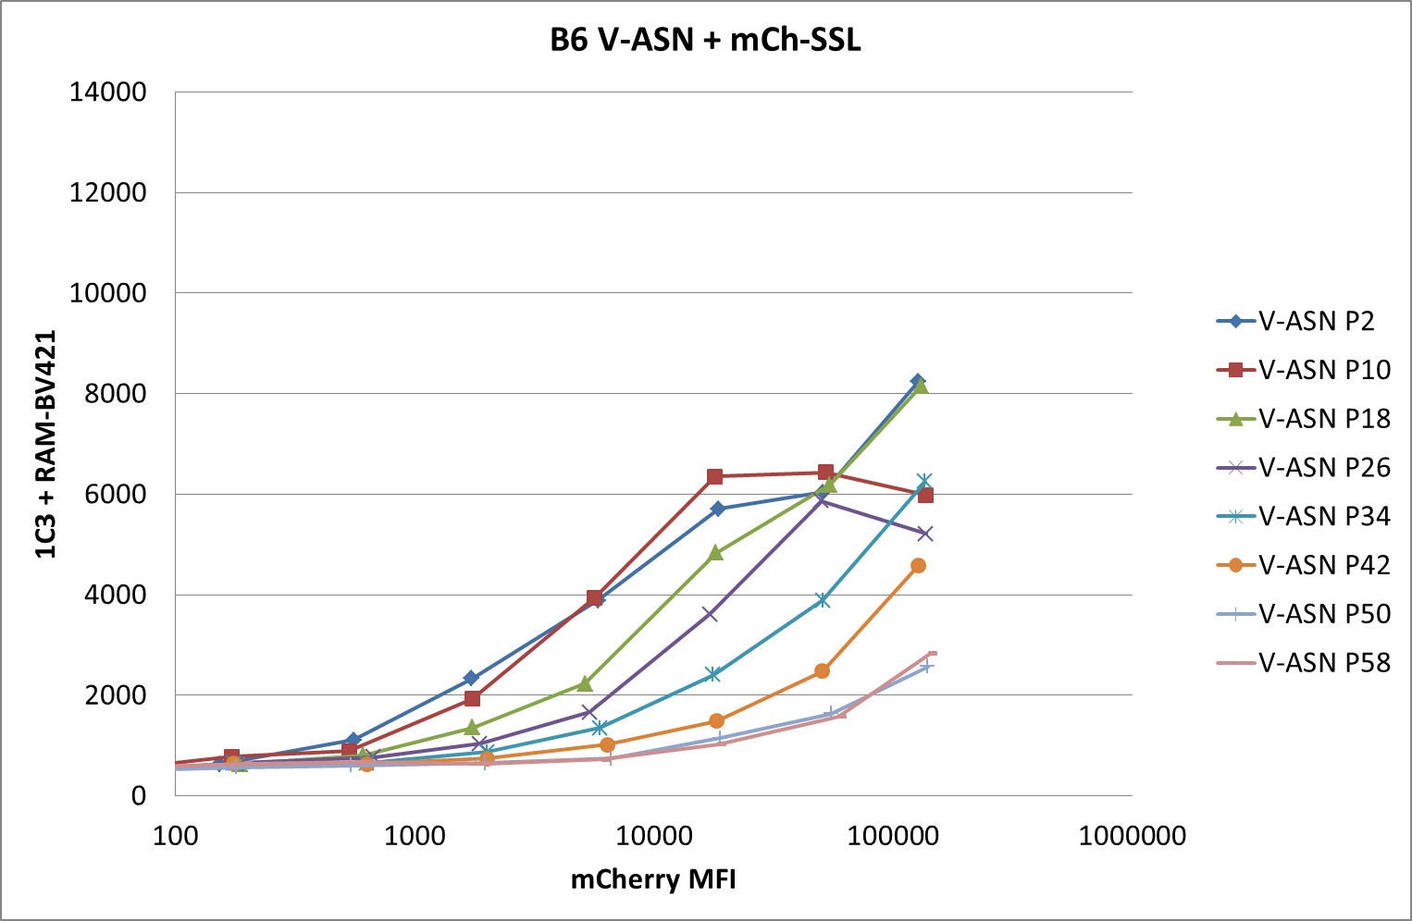
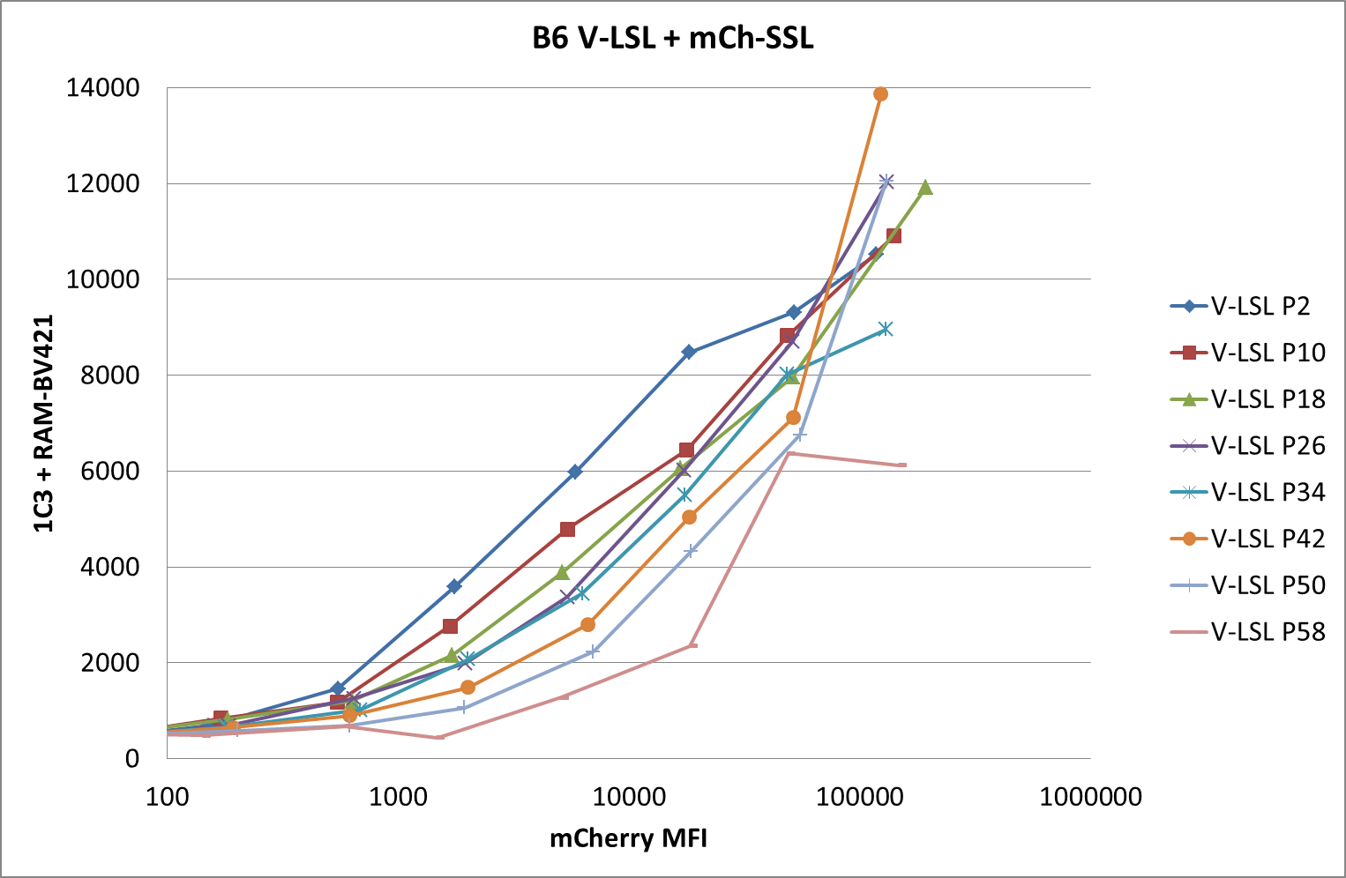
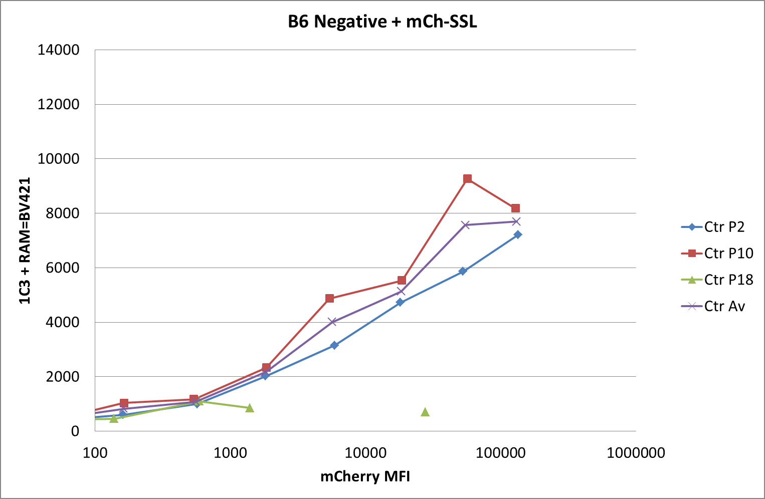
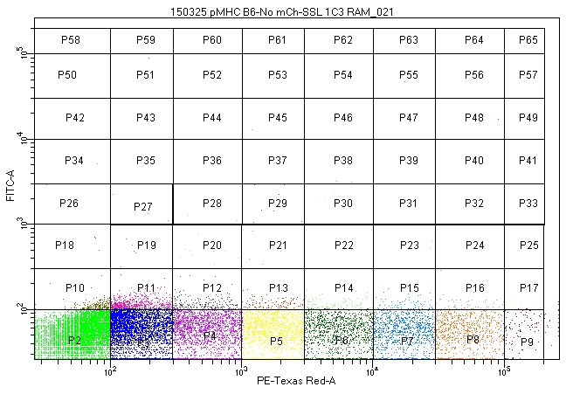
150325 pMHC competition
Notes:
Repeat of 150318: much lower MFIs but same results

Slide 6
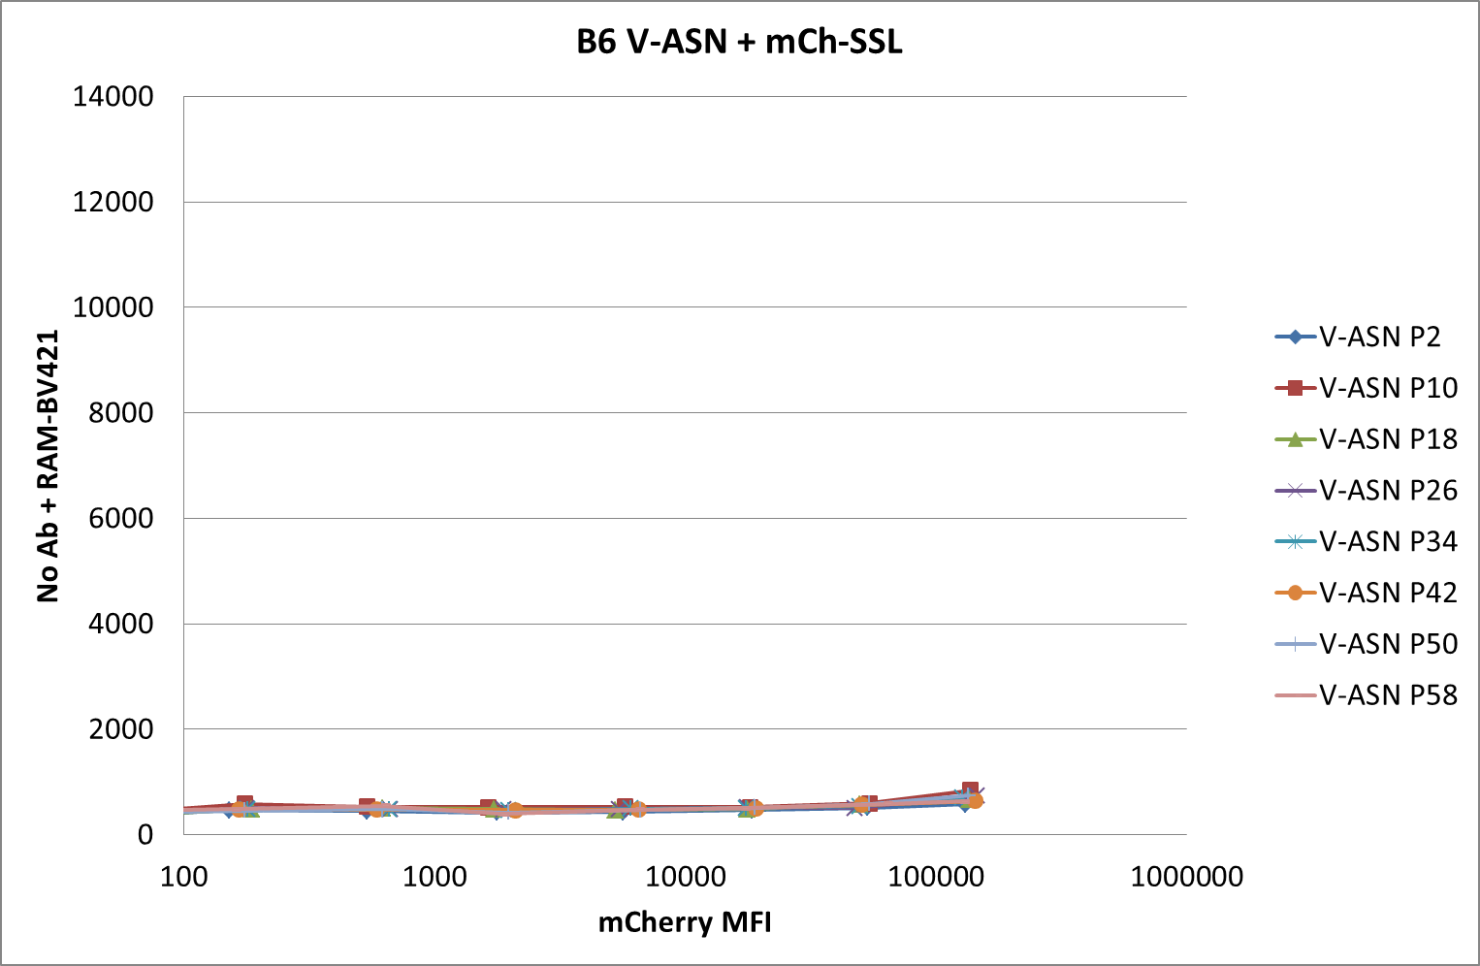
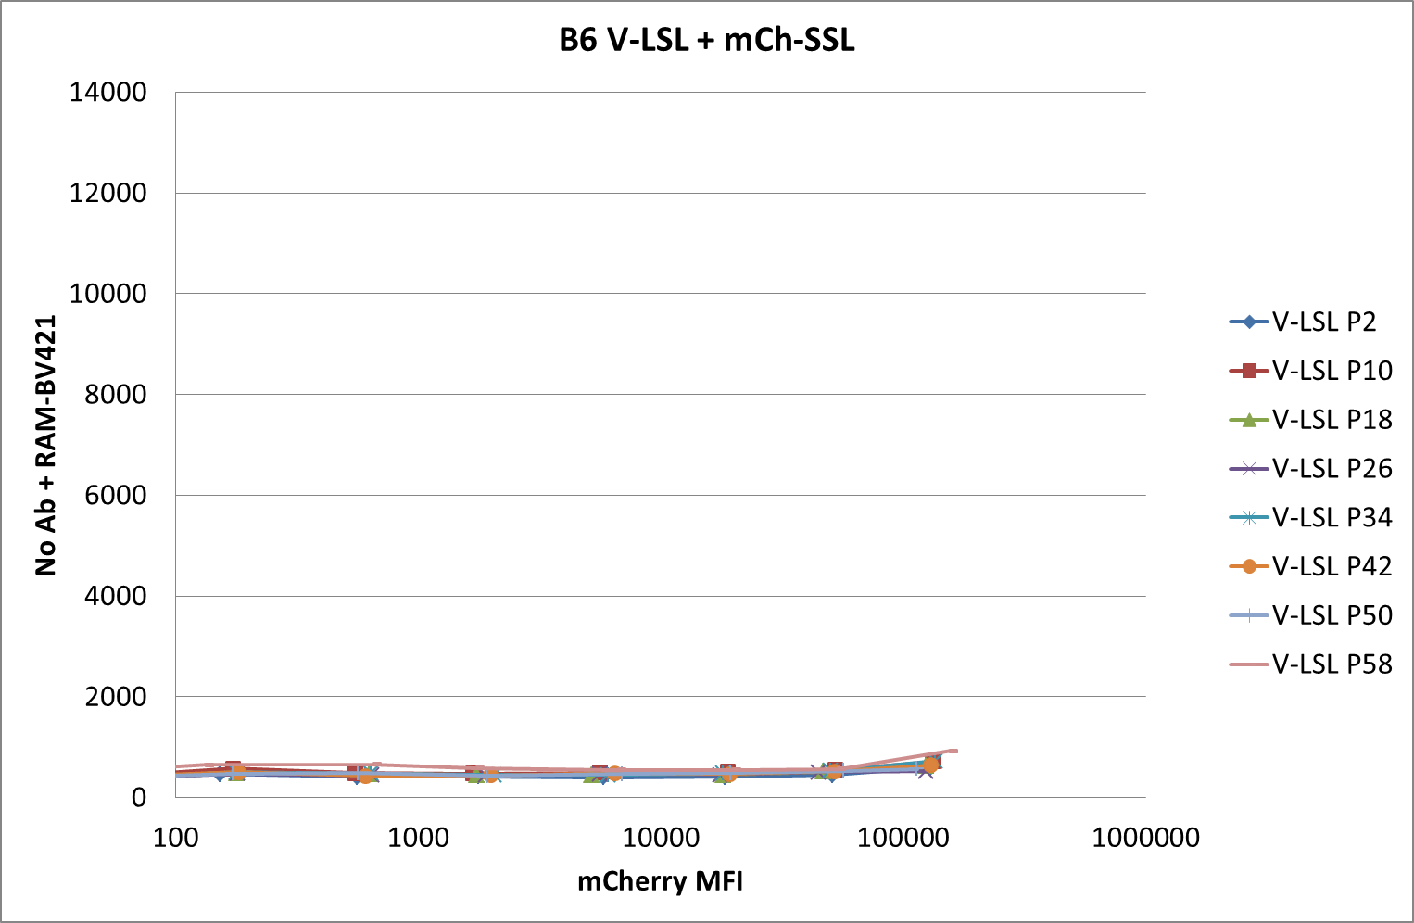
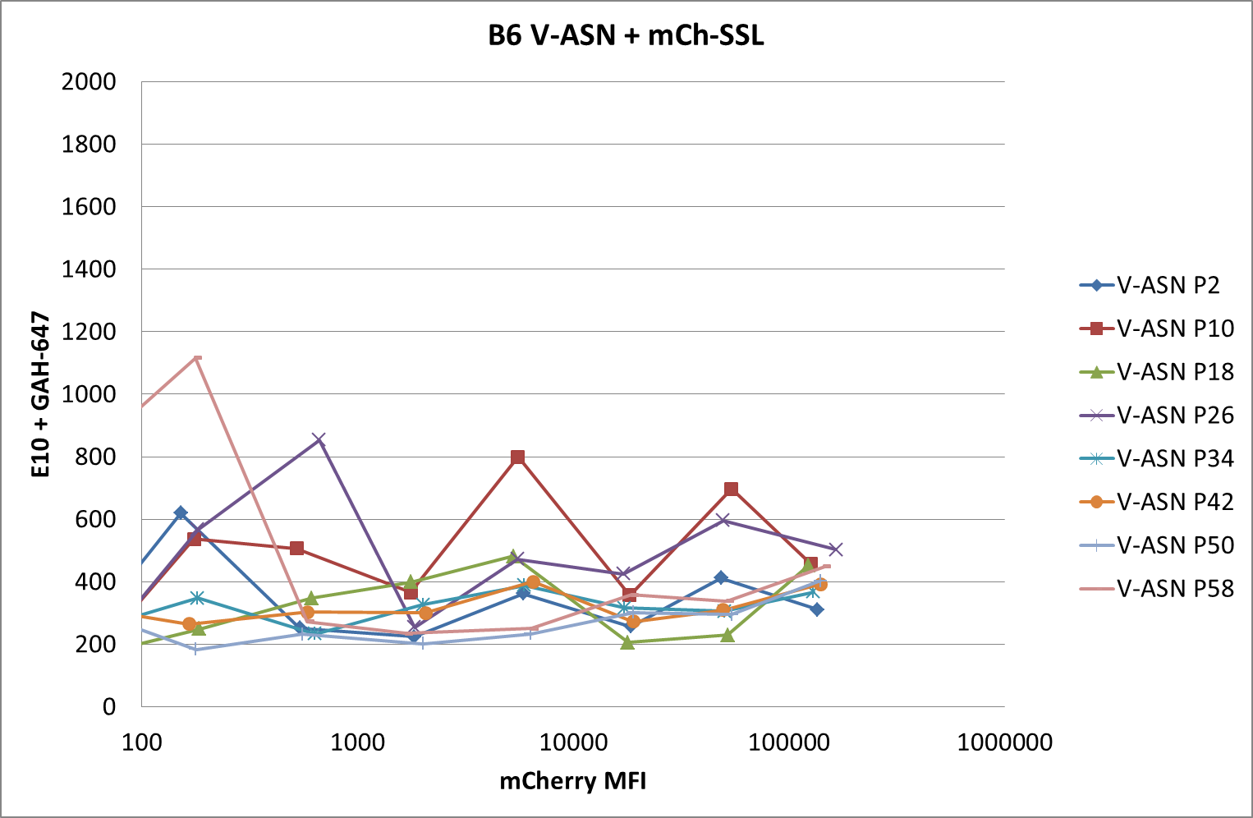
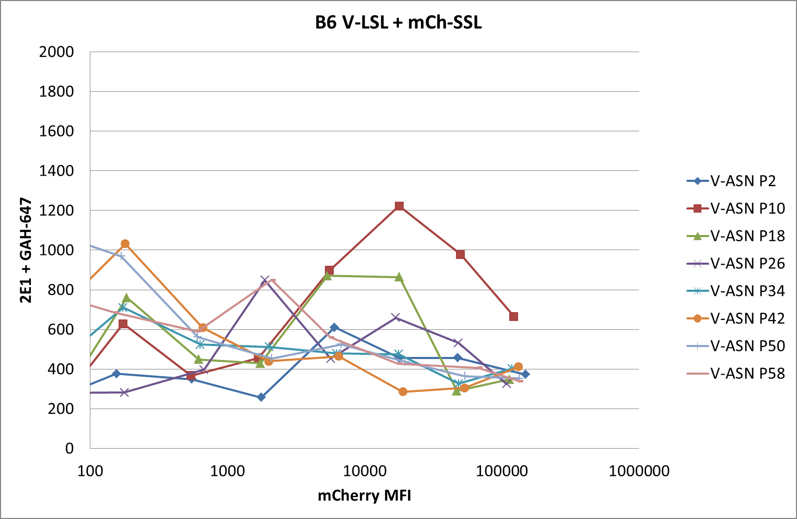
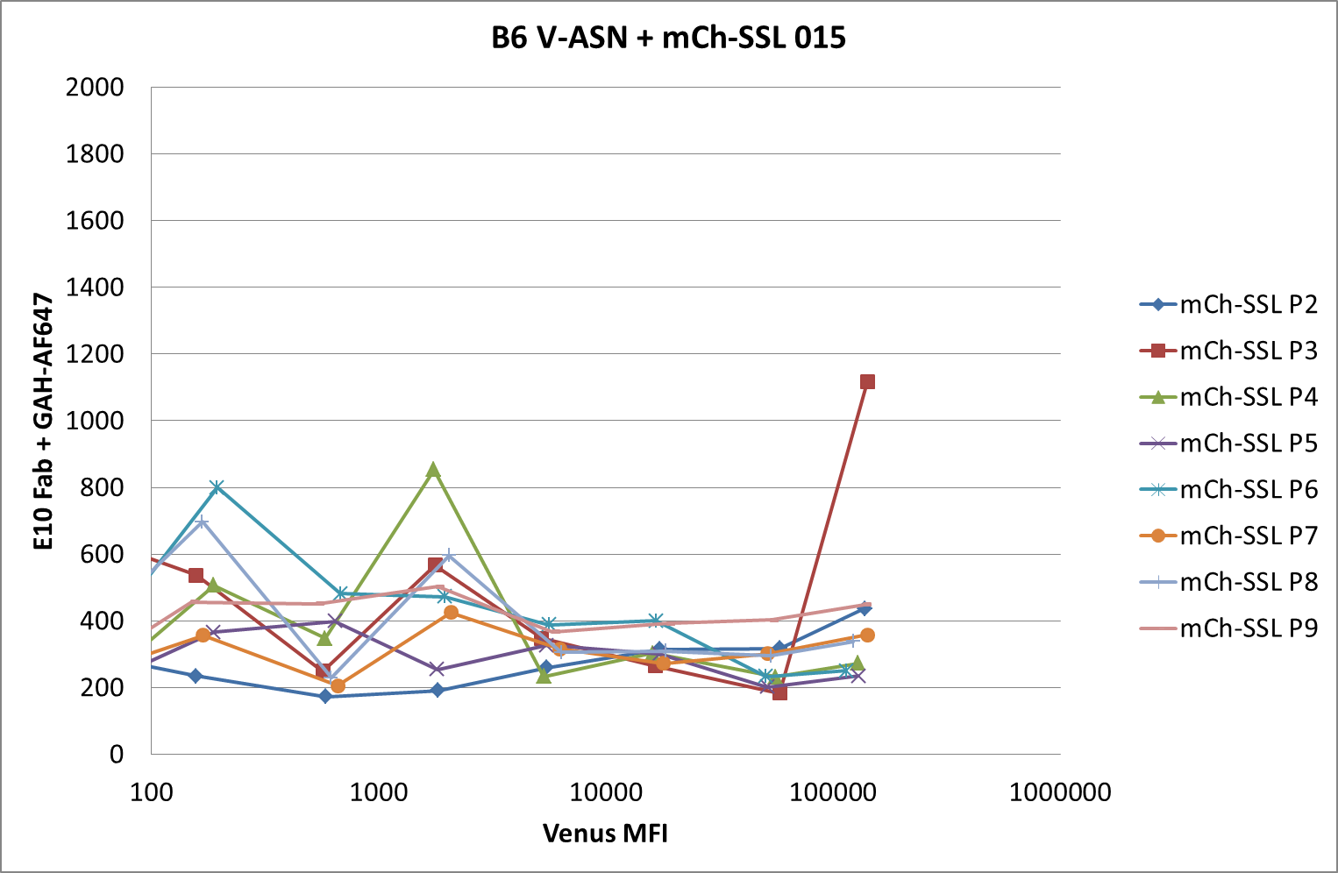
150325 pMHC competition
LSL not ASN
Notes:
Top: negative controls
Bottom: E10 and 2E1 old Fab stocks are not concentrated enough

Slide 7
Results:
Competition confirmed using 1C3 FabMab + RAM-BV421
Staining with second Fab in parallel:
No staining with E10: too old? Yes.
2E1: poor staining
Compare transfection efficiencies in 6W plates and in 10 cm P.d.
V-ASN 56.5%
V-LSL 52.5%
V-SSL 58.8%
mCh-SSL 60.9%
10 cm P.d. 50%
Compare RAM-BV421 and GAM-AF647 using V-SSL transfected cells + 1C3 FabMab

Slide 8
150401 pMHC competition
Reminder: the ultimate aim of this project is to compare competitions in the presence and in the absence of tapasin. However, previous experiments showed that due the low MHC surface expression in Tpn KO cells detection of our model pMHC complexes is problematic. We will need to boost the MHC expression in Tpn KO cells by treating the cells with IFNg. We need therefore to check first in wt cells that IFNg treatment does not affect the competitions.
Method:
Cells: C57BL/6 fibroblasts: 2 wells of a 6 W containing 10⁵ cells / 3 ml
+/- mIFNg (1 ul / well)
Transfections: V-ASN, V-LSL or V-SSL + mCh-SSL
Detection: 1C3 FabMab + GAM-AF647 @1:2,000
Aims:
Confirm competition using 1C3 FabMab + GAM-AF647
Confirm results in the presence of IFNg
Test transfection efficiencies in 6 cm diameter P.d.

Slide 9
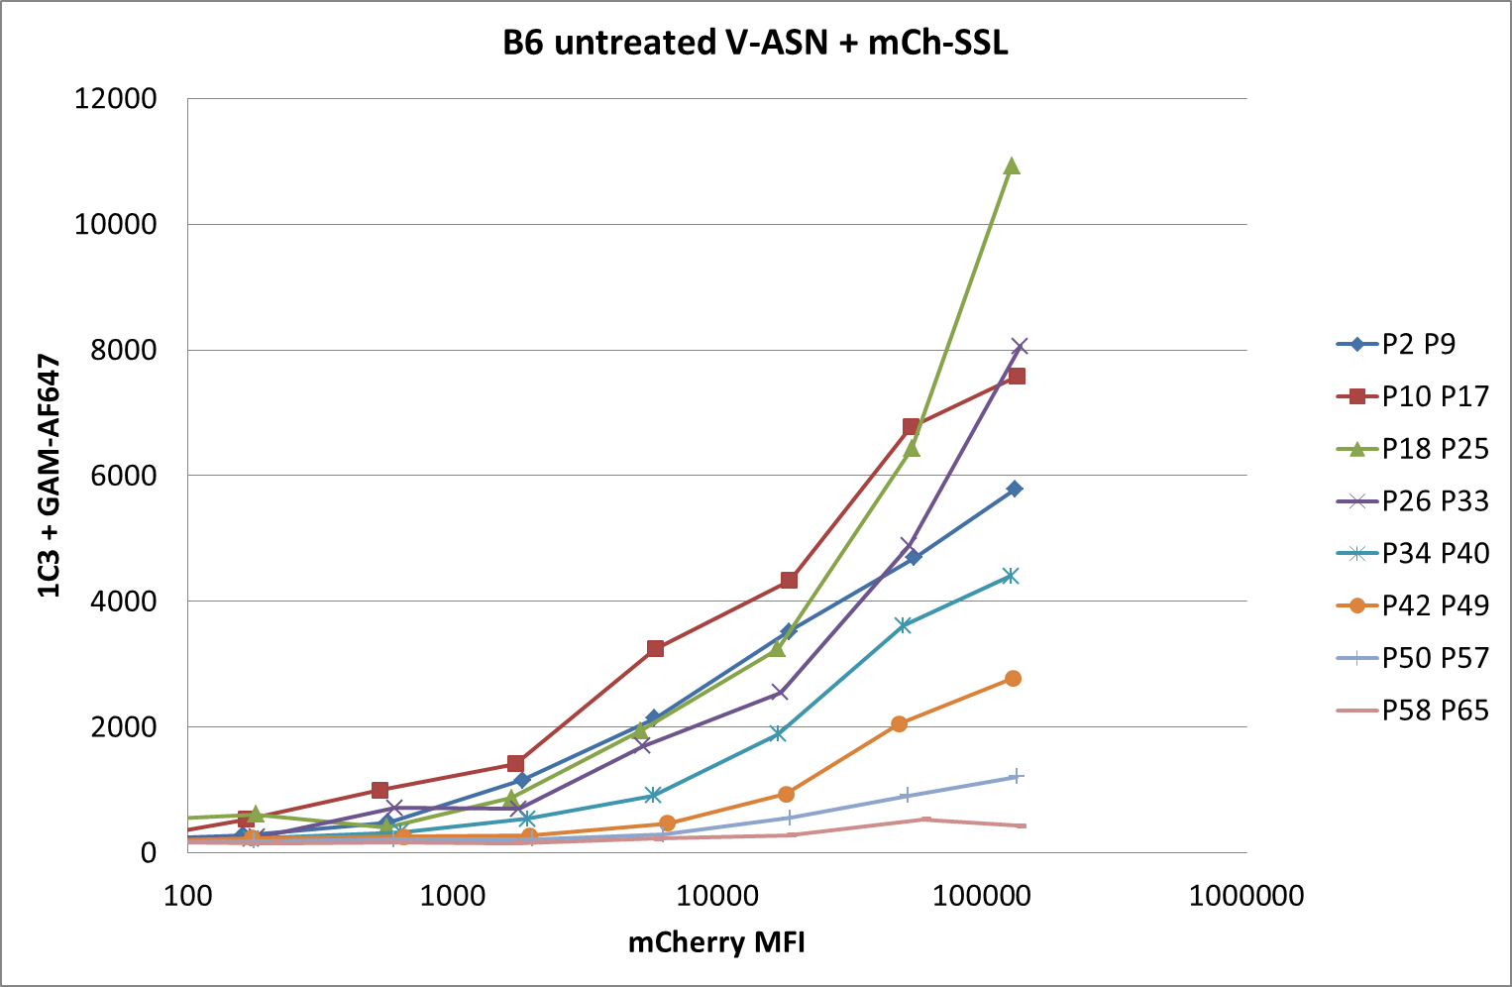
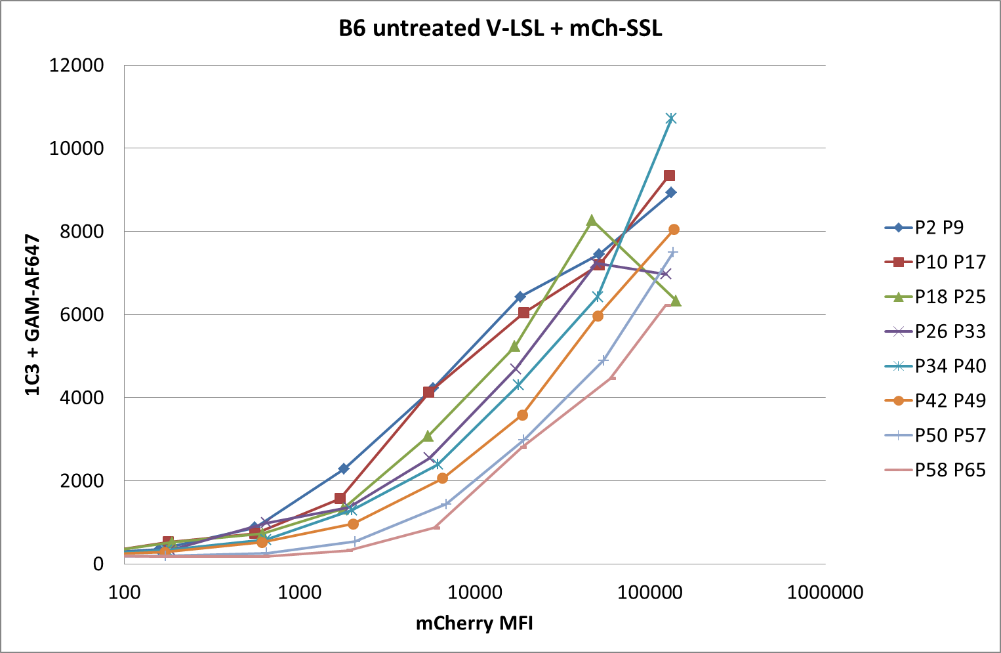
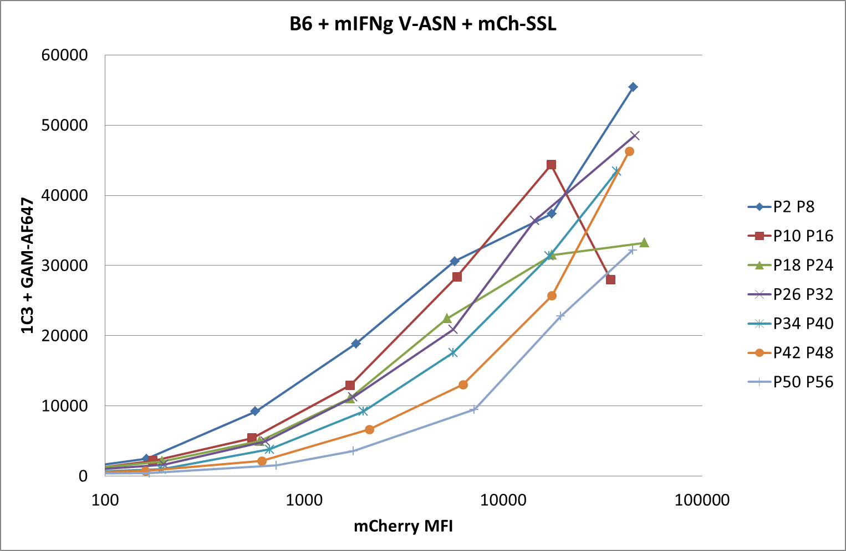
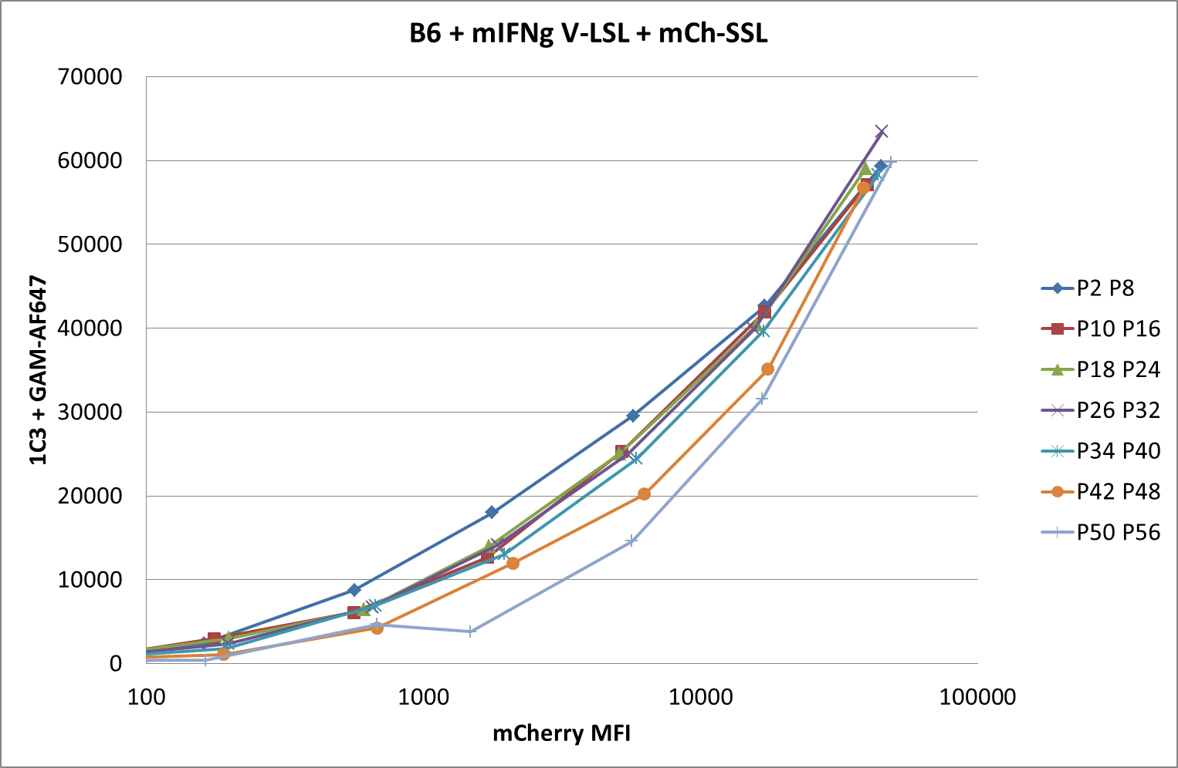
150401 pMHC competition
B6 fibroblasts +/- mIFNg
Notes:
IFNg treatment increases MHC expression and therefore competition is reduced (ASN) or nearly inexistent (LSL).
Try to repeat this experiment adding the level of transcription of TAP, Tpn and MHC.

Slide 10
150422 pMHC competition
Cells: C57BL/6 fibroblasts: 6 cm P.d. containing 2x10⁵ cells / 6 ml
+/- mIFNg
Transfections: V-ASN, V-LSL or V-SSL + mCh-SSL
Detection: 1C3 FabMab + GAM-AF647 @1:2,000
2E1 Fab + GAH-IgG (H+L)-AF647 @1:200
Aims:
Confirm competition using 1C3 FabMab
Confirm results in the presence of IFNg
Staining with second Fab in parallel

Slide 11
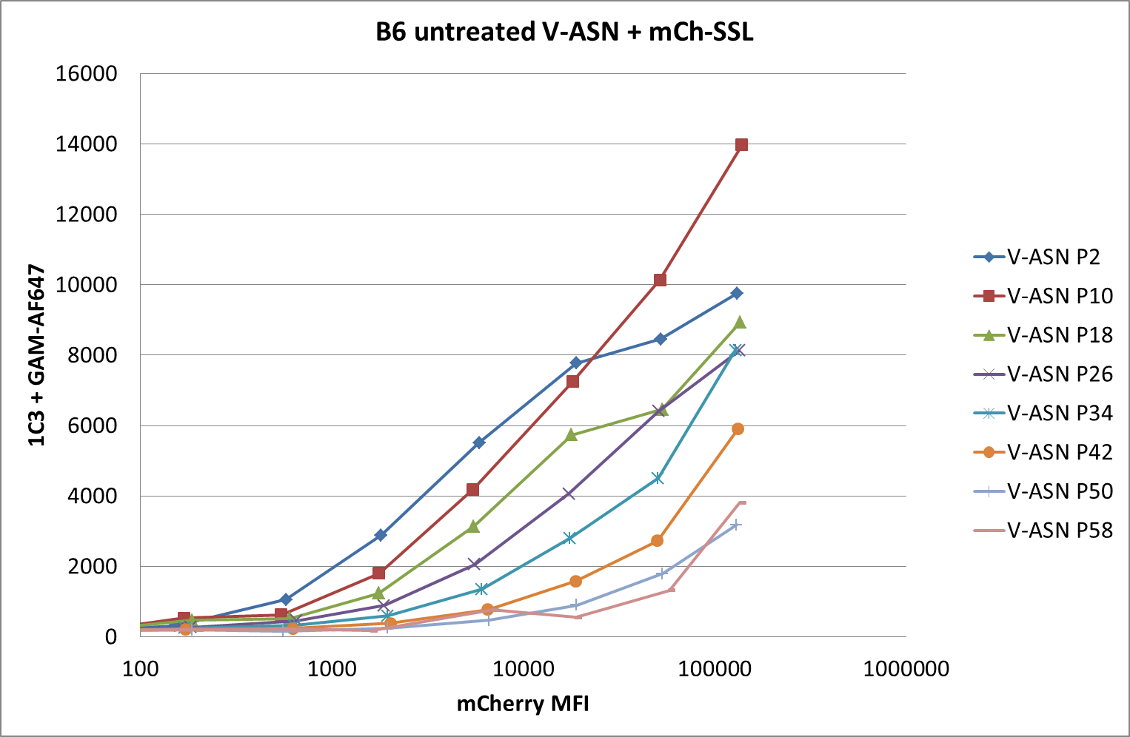
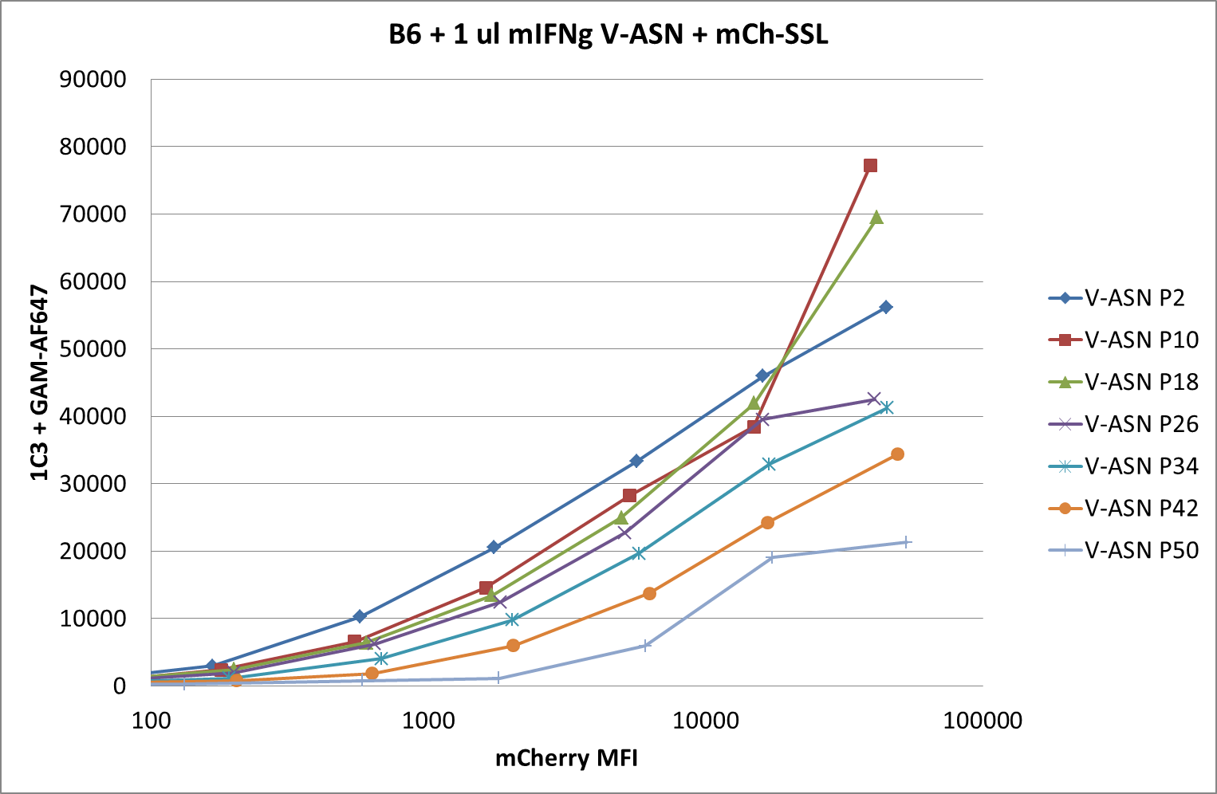
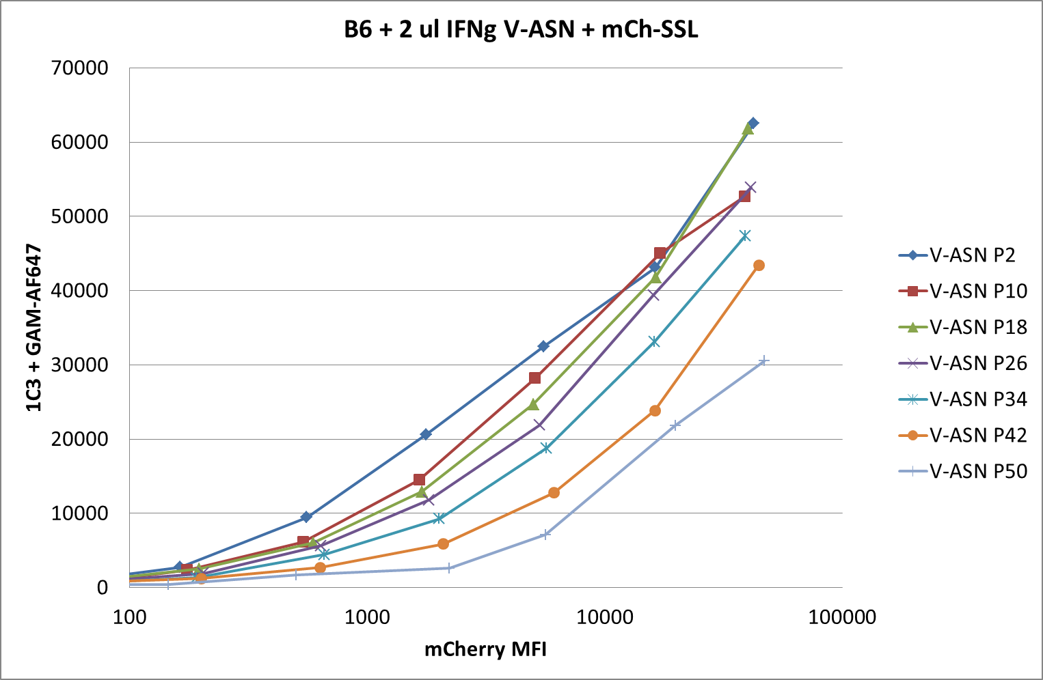
150422 pMHC competition
B6 fibroblasts +/- mIFNg
Notes:
Repeat of 150401, same results

Slide 12
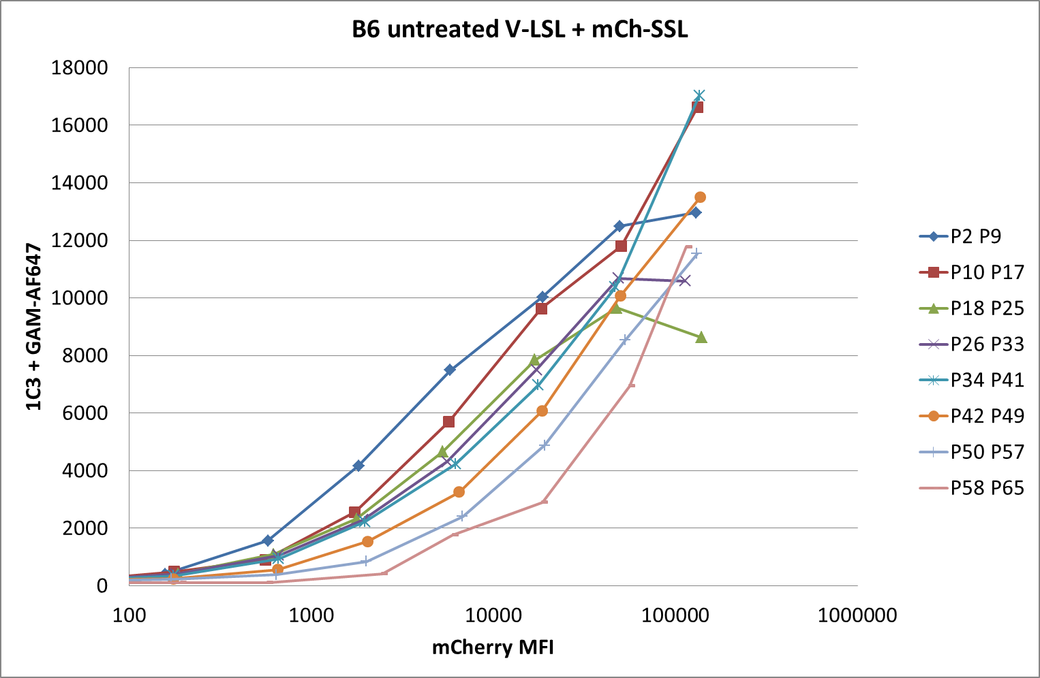
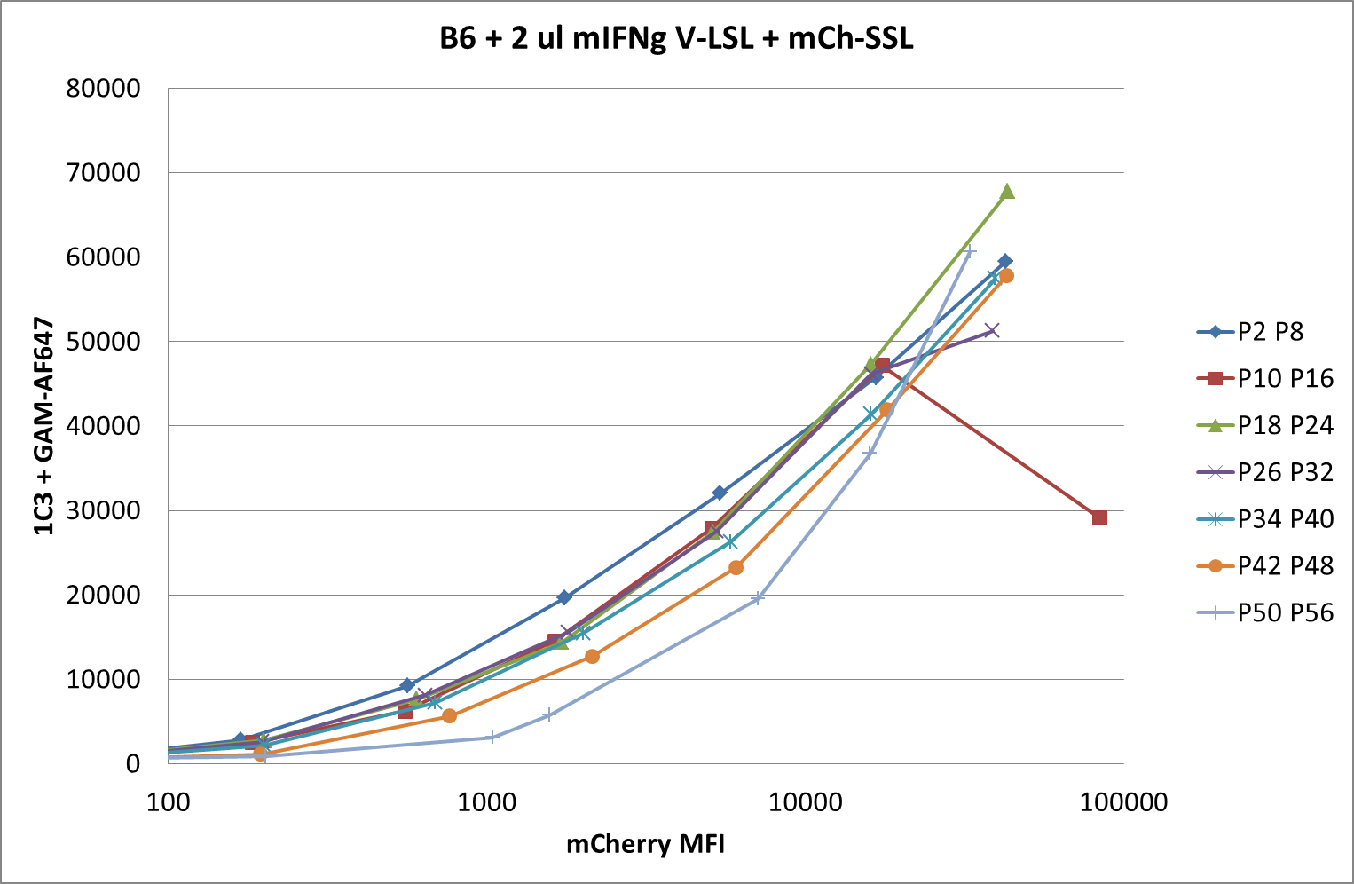
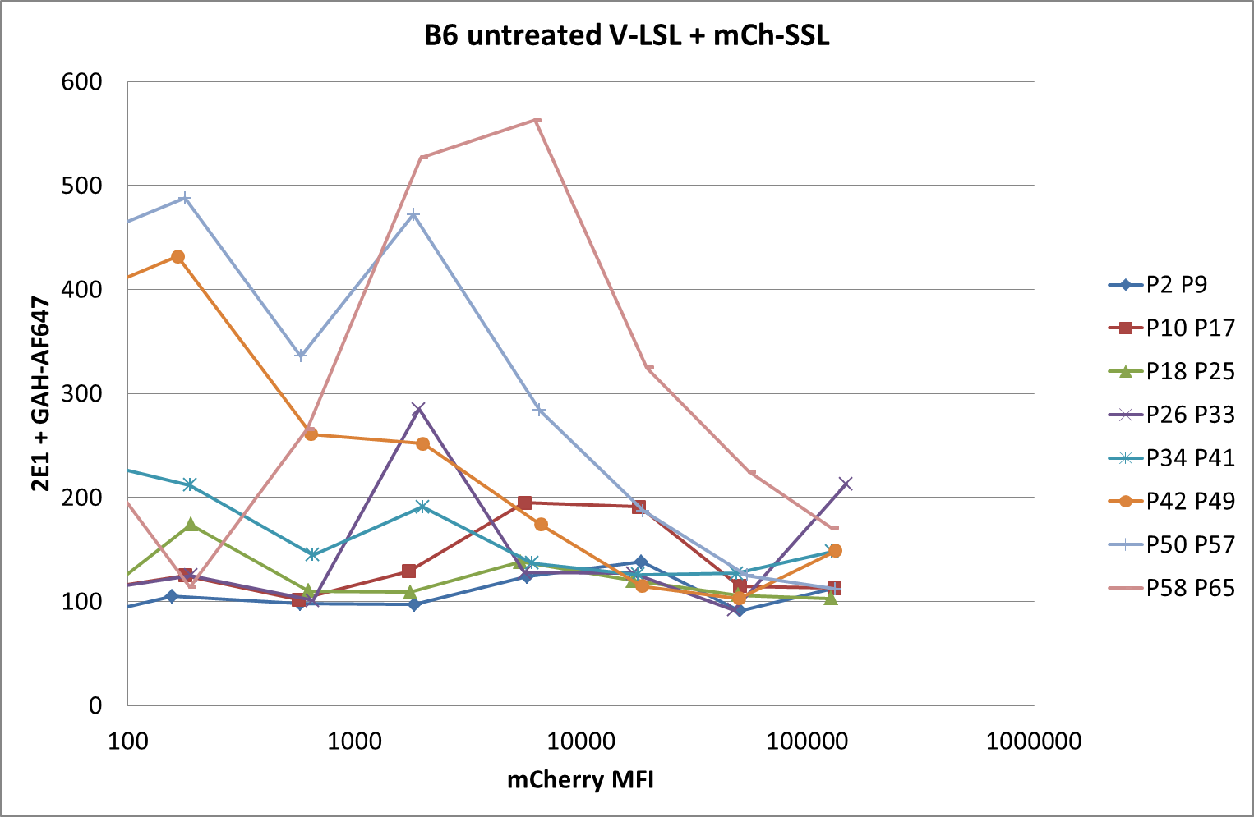
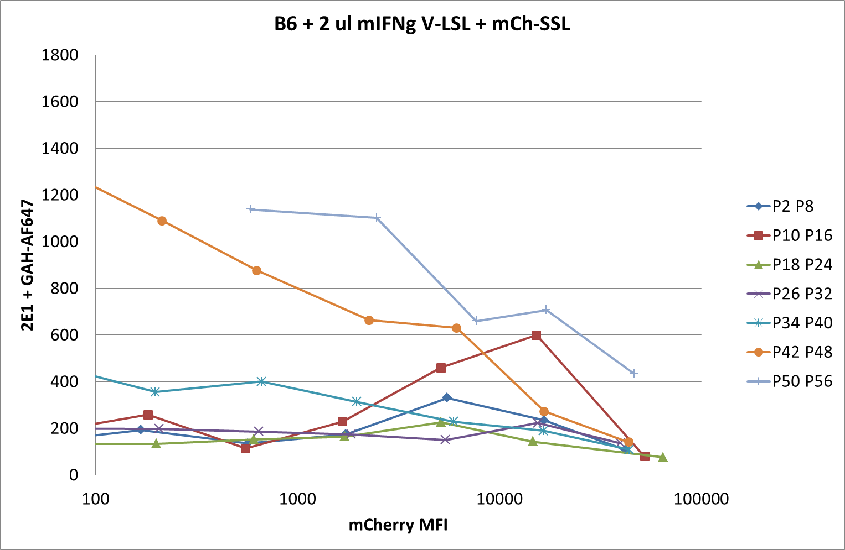
150422 pMHC competition
B6 fibroblasts +/- mIFNg
Notes:
Repeat of 150401 with 2E1 Fab staining in parallel (bottom graphs):
Some LSL surface expression can be detected in untreated cells at the highest levels of Venus expression. After IFNg treatment LSL expression is much higher. Therefore IFNg treatment allows efficient surface expression of both peptides.

Slide 13
150422 pMHC competition
B6 fibroblasts +/- mIFNg

Slide 14
Future work:
Compare wt, Tpn KO, E°Tpn°
REMINDER:
Even after treatment with IFNg, pMHC surface expression is still hardly detectable on Tpn KO cells. As Edd showed that overtrimming of the CT26 epitope GSW11 is enhanced in cells where contact between MHC I and Tapasin is inhibited (T134K mutant), I started wondering if my model peptides were also being destroyed by ERAP in the absence of tapasin and tested their surface expression in the presence or absence of LeuSH ERAP inhibitor.

Slide 15
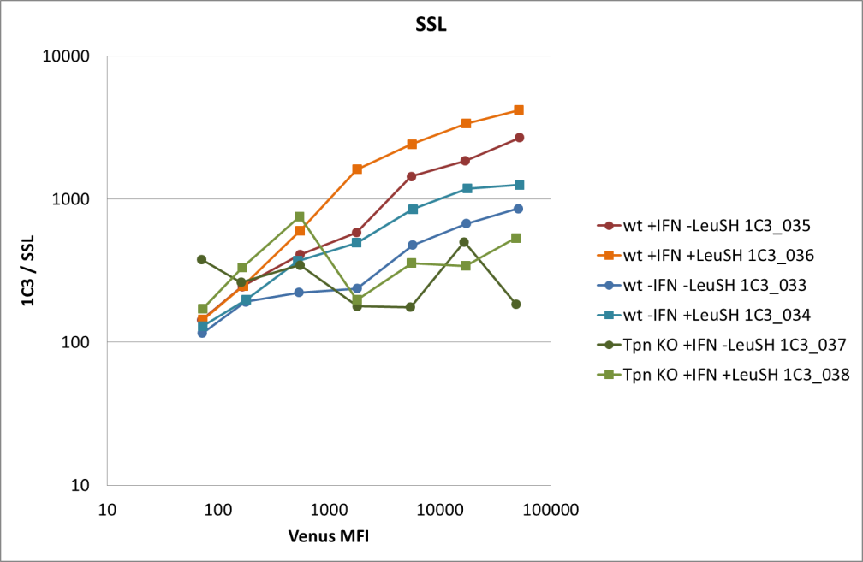
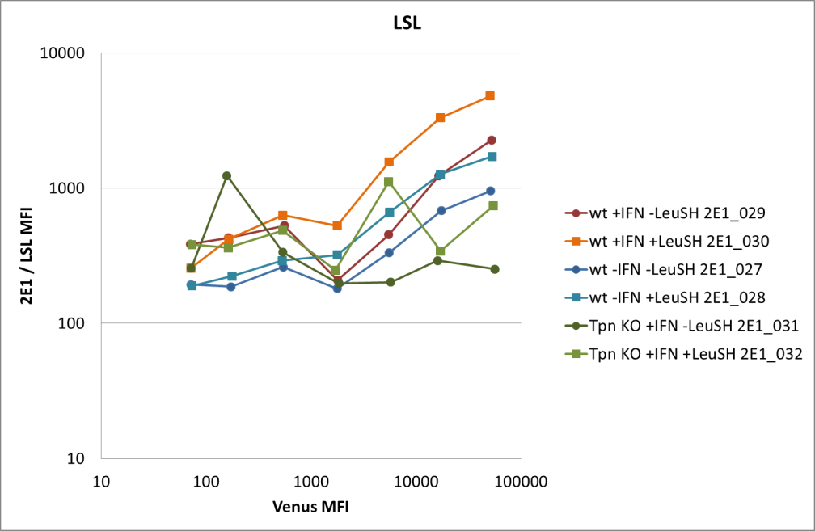
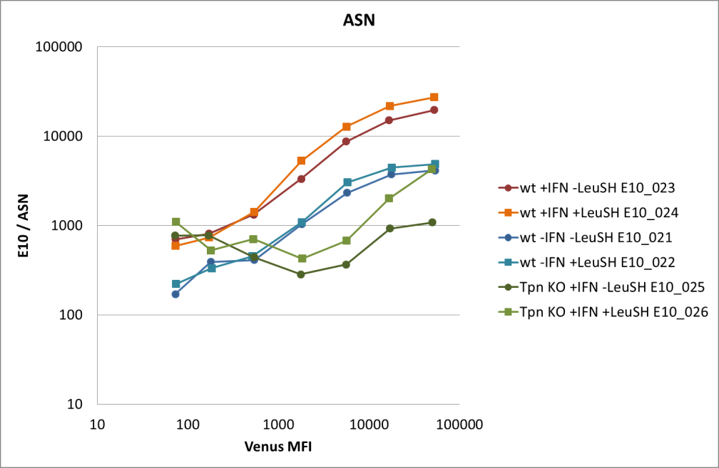
130620 wt or Tpn KO fibroblasts transfected with Venus-Ub-peptide
Treated or not with IFNg and LeuSH + DTT
Fab + anti-hC κ/λ -biotin + Streptavidin-APC
Notes:
ERAP inhibition improved surface expression of the three model peptides in all conditions (Wt or Tpn KO cells, treated or not with IFNg). ASN seems to be the least affected.
ASN seems to be the least affected by the absence of tapasin. Tpn independent?

Slide 16
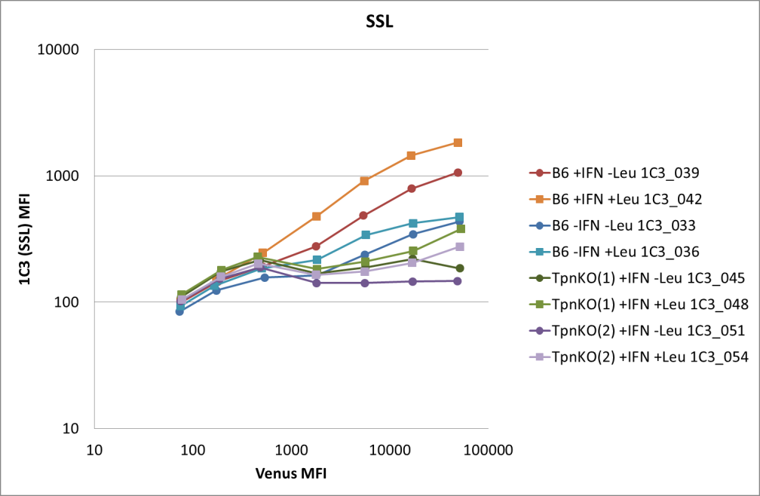
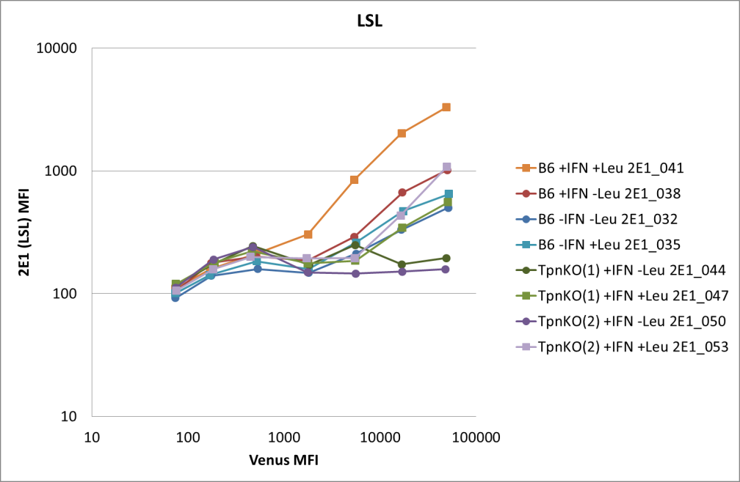
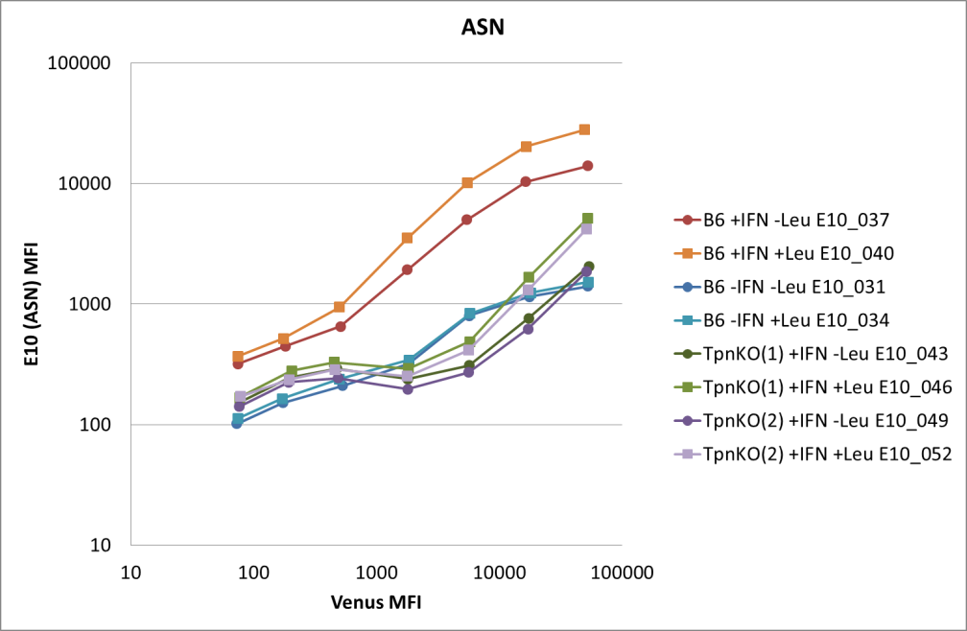
130710 wt or Tpn KO fibroblasts transfected with Venus-Ub-peptide
Treated or not with IFNg and LeuSH + DTT
Fab + anti-hC κ/λ Mab + RAM IgG1- BV421
Sensitivity to ERAP:
LSL > SSL > ASN
Notes:
Previous results confirmed.

Slide 17
150507 pMHC competition
Using LeuSH does not guarantee 100% inhibition of ERAP and the % of inhibition might vary between experiments. To obtain a better consistency I will be using ERAP Tpn double KO cells obtained from Nilab Shastri.
Cells: C57BL/6 fibroblasts, Tpn KO fibroblasts and ERAP and Tpn double KO
6 cm P.d. containing 2x10⁵ cells / 6 ml
+/- mIFNg
Transfections: V-ASN, V-LSL or V-SSL + mCh-SSL
Detection: 1C3 FabMab + GAM-AF647 @1:2,000
2E1 Fab + GAH-IgG (H+L)-AF647 @1:200

Slide 18
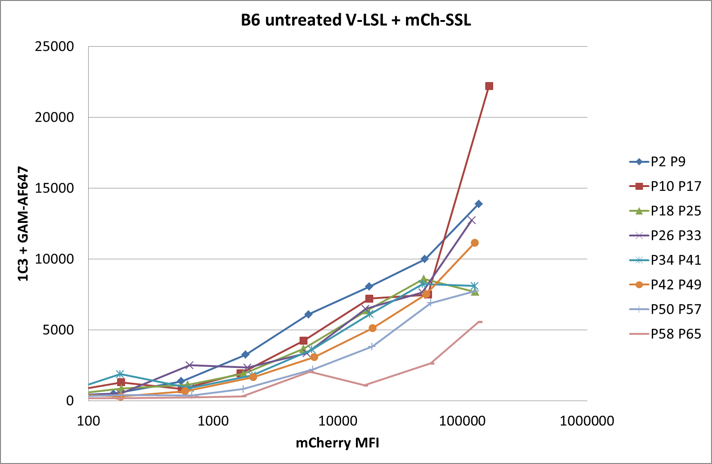
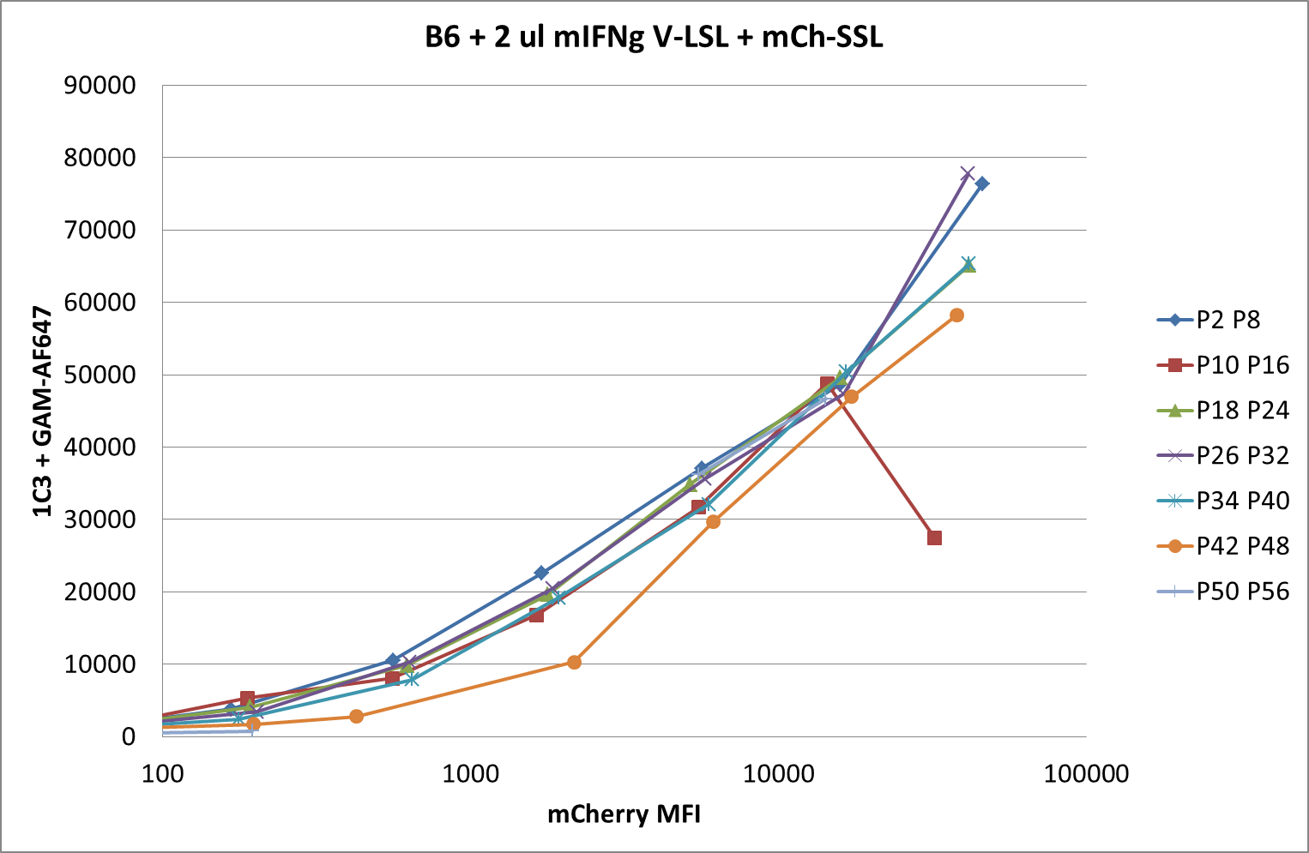
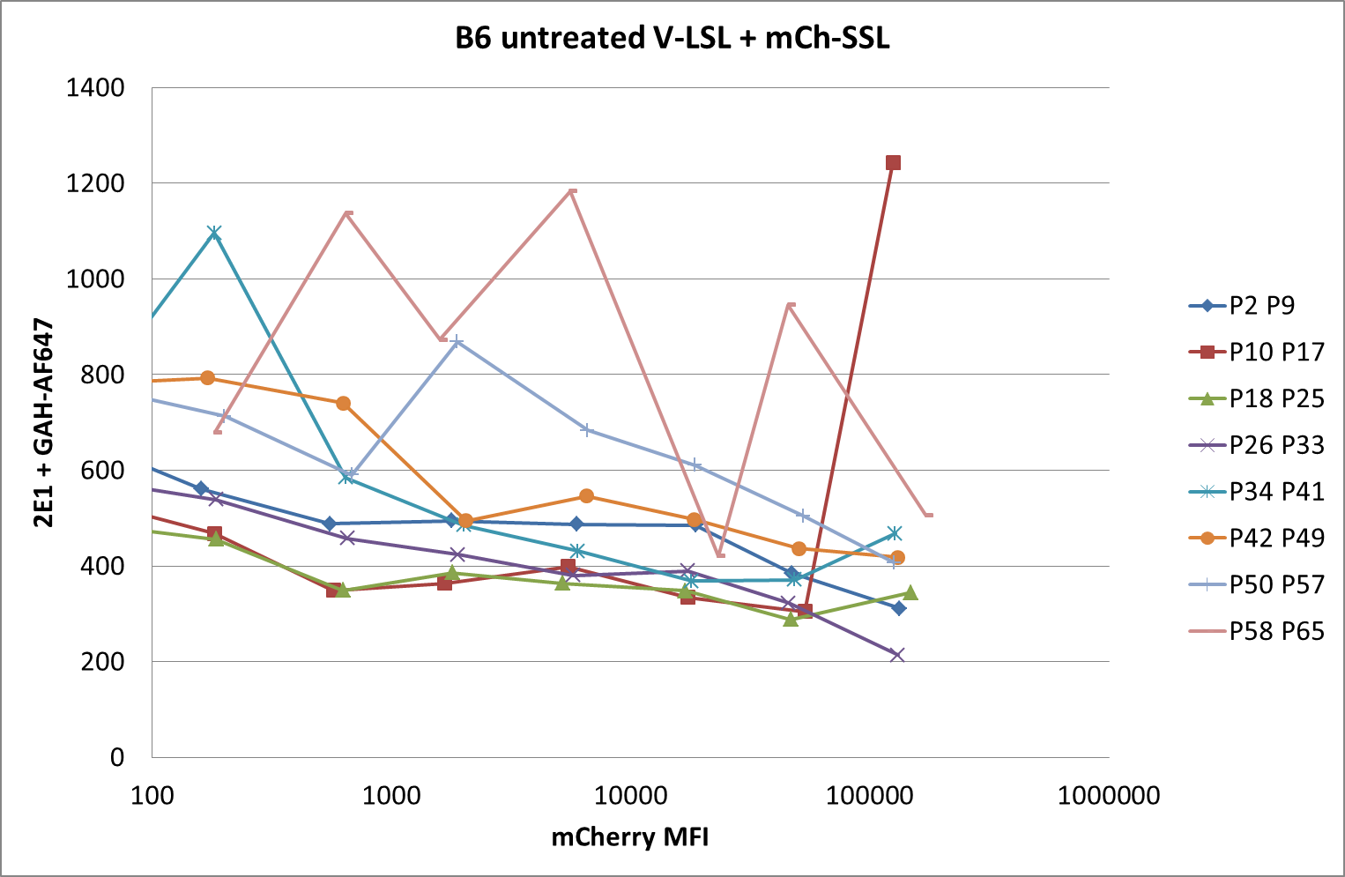
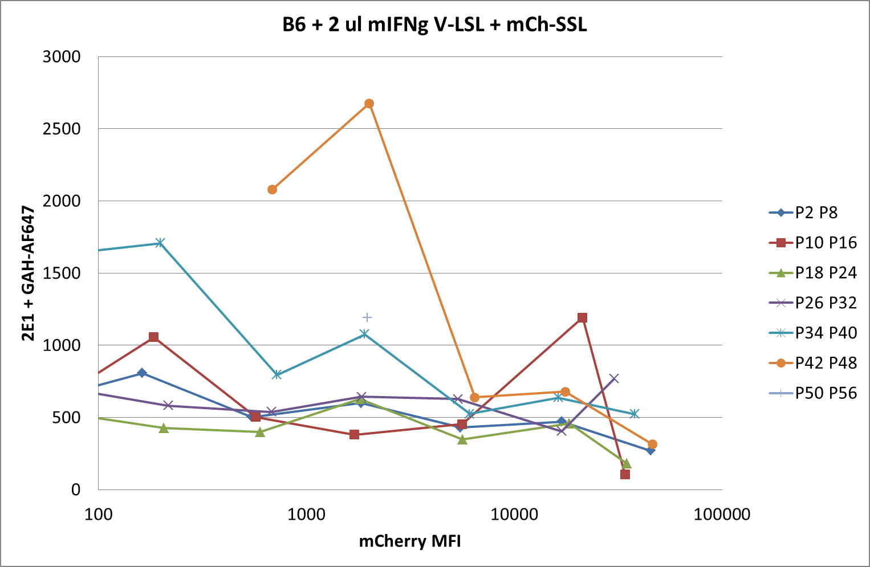
150507 pMHC competition
B6 wt fibroblasts +/- mIFNg
Not enough cells
Notes:
Transfection efficiency lower than usual

Slide 19
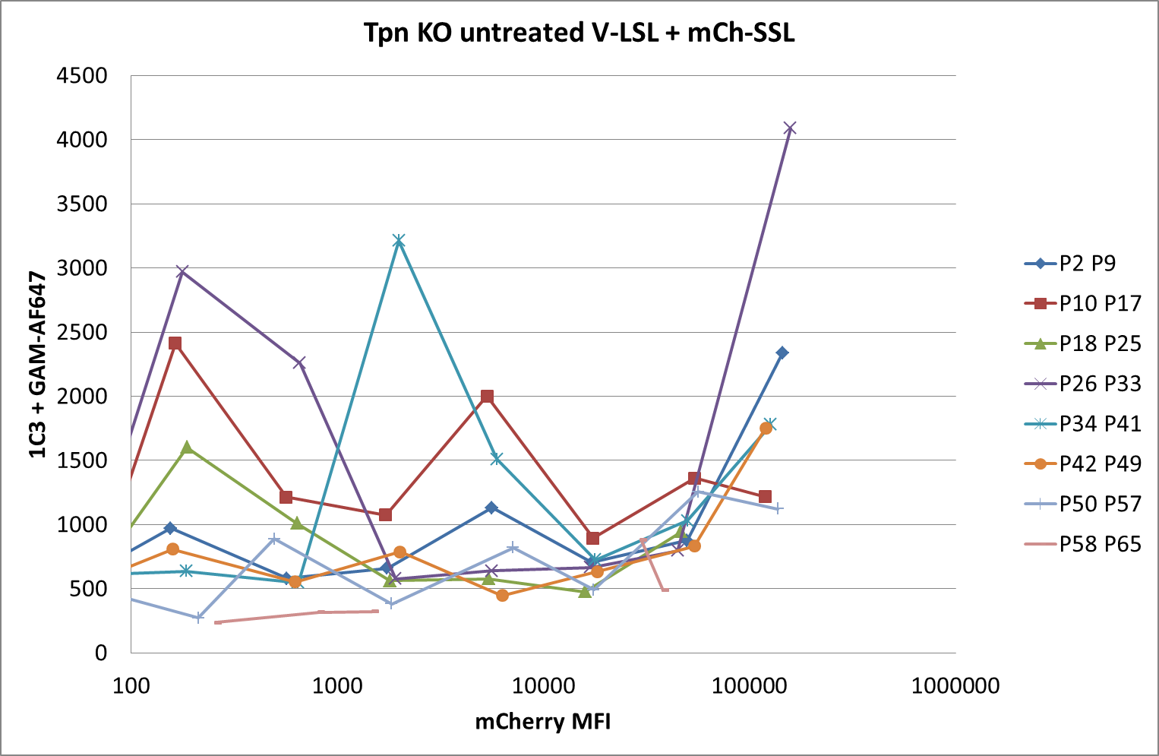
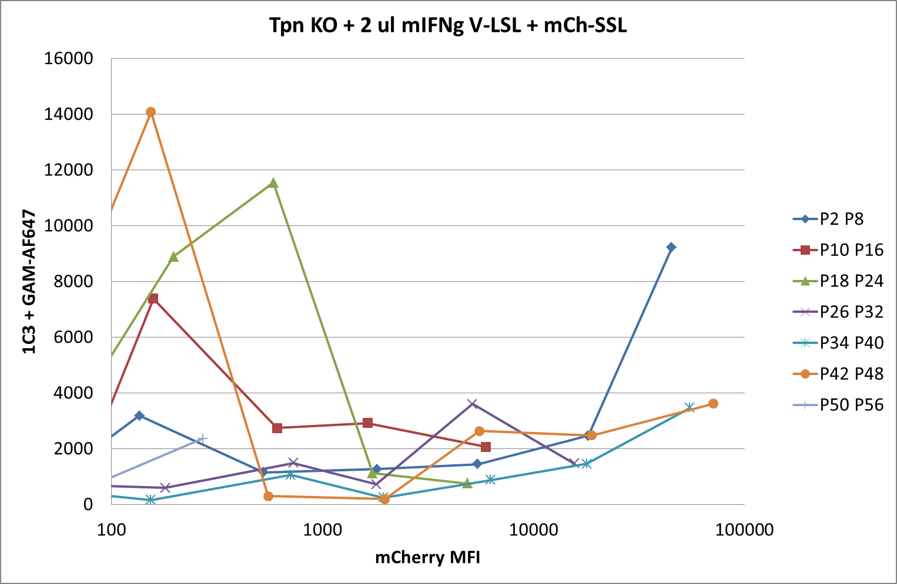
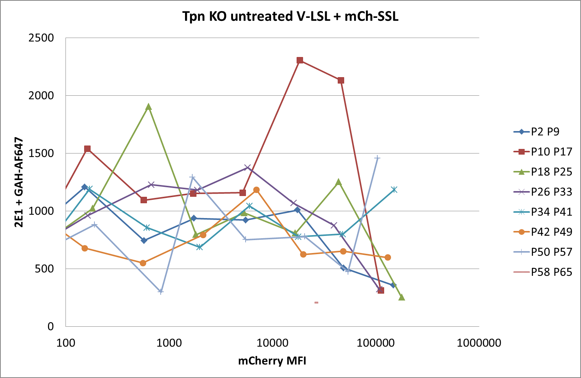
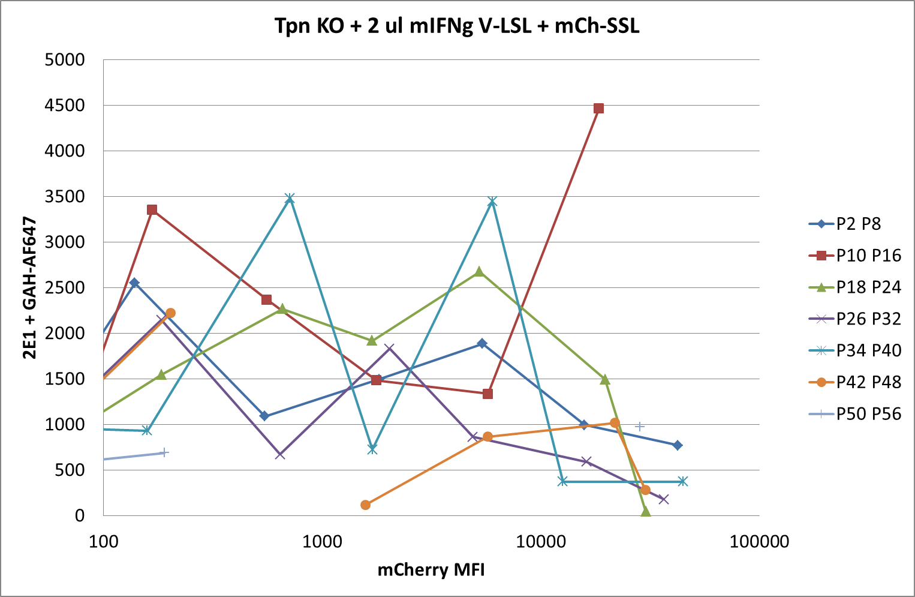
150507 pMHC competition
Tpn KO fibroblasts +/- mIFNg
Very poor transfection efficiency
especially in the presence of IFNg
Notes:
Only BG

Slide 20
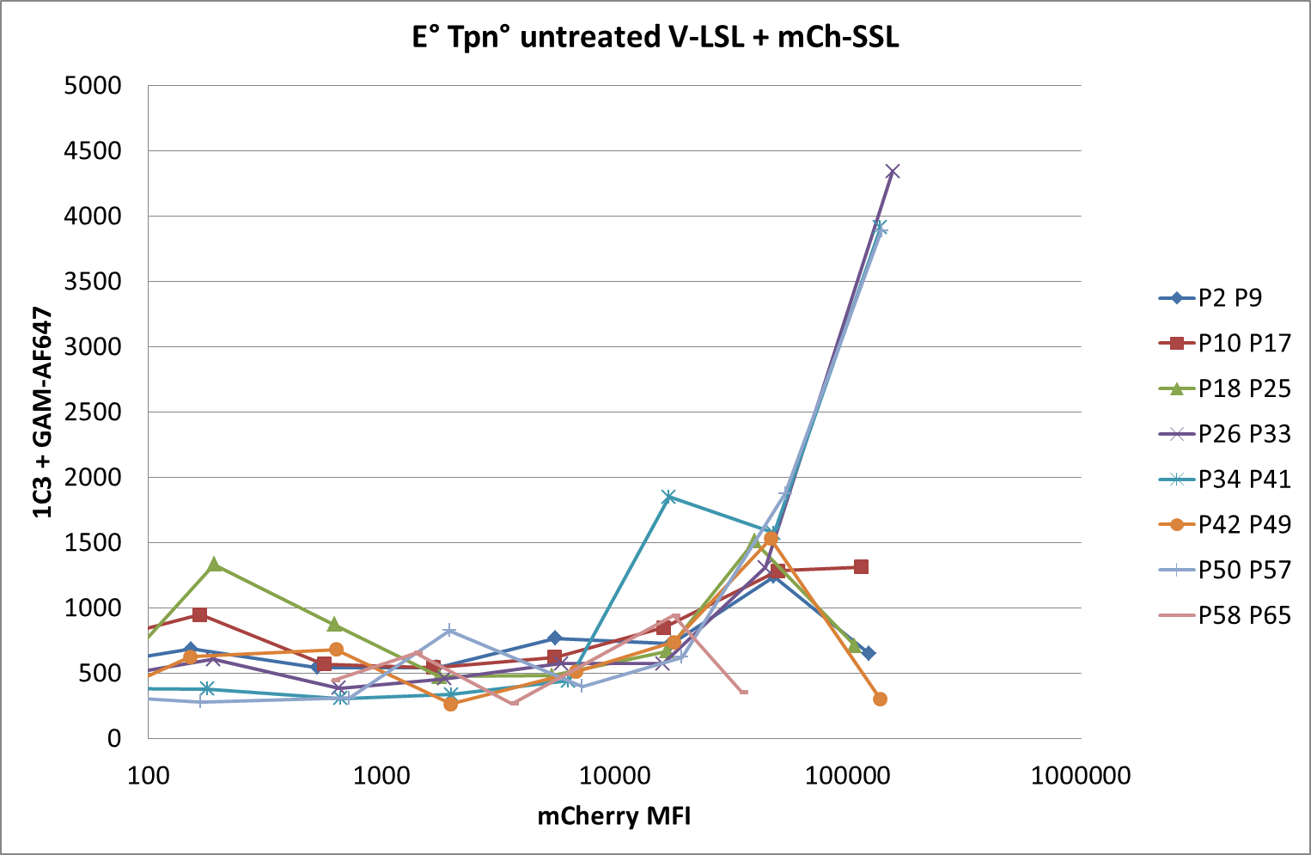
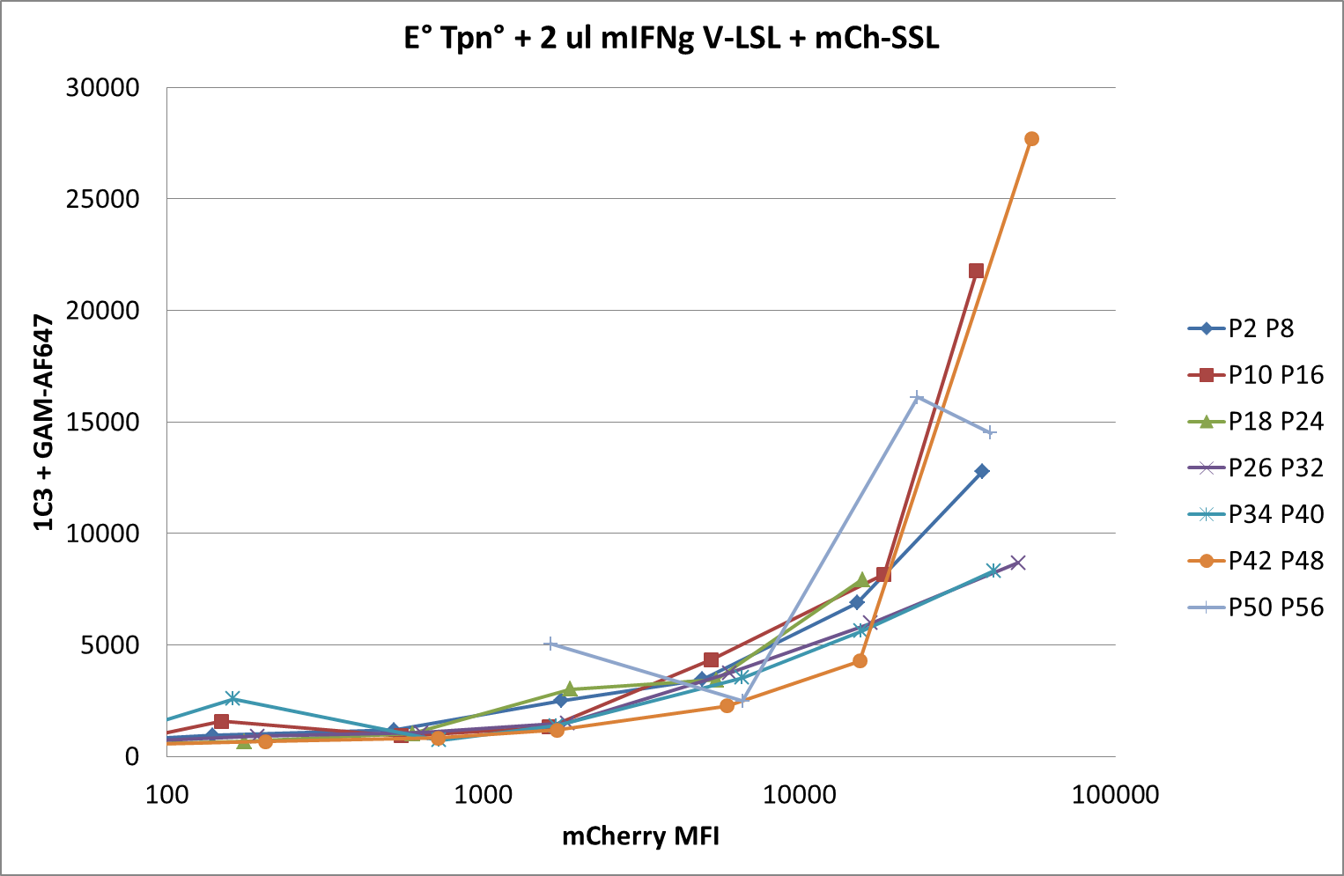

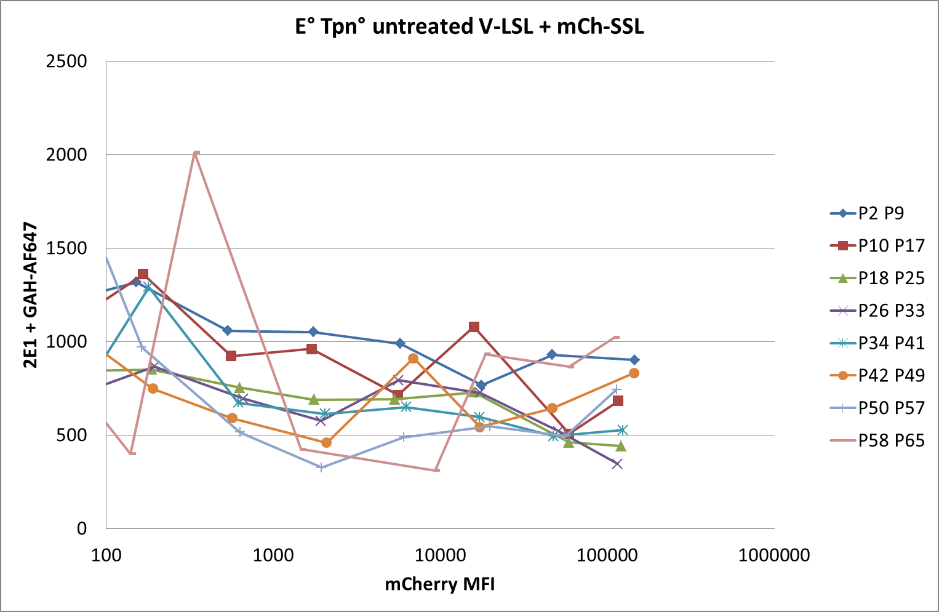
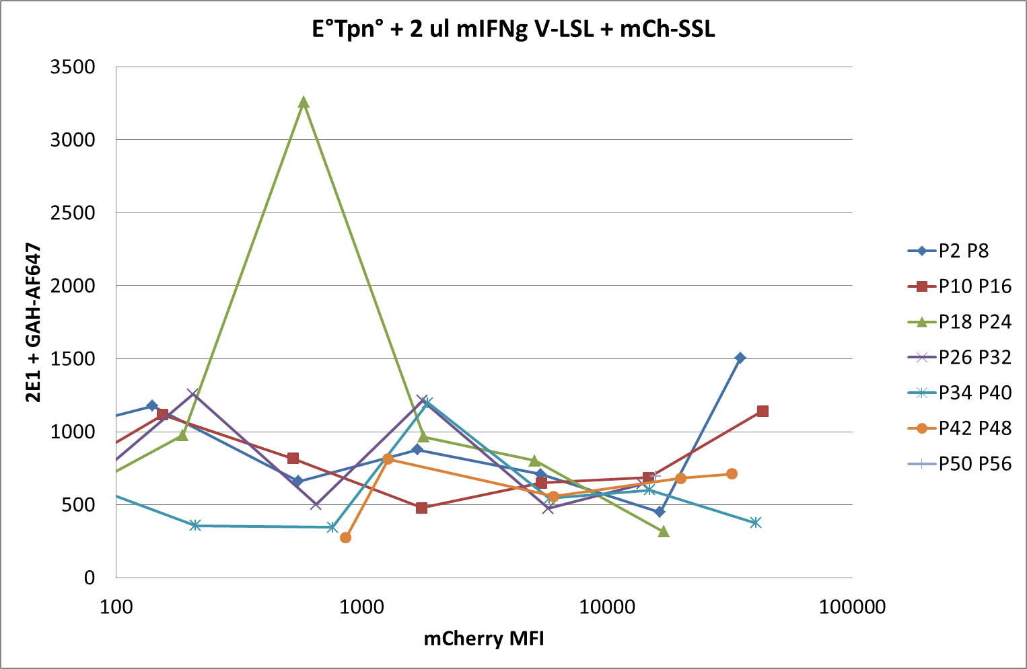
150507 pMHC competition
B6 E°Tpn° fibroblasts +/- mIFNg
Not enough cells
Notes:
SSL can be detected at high levels of expression

Slide 21
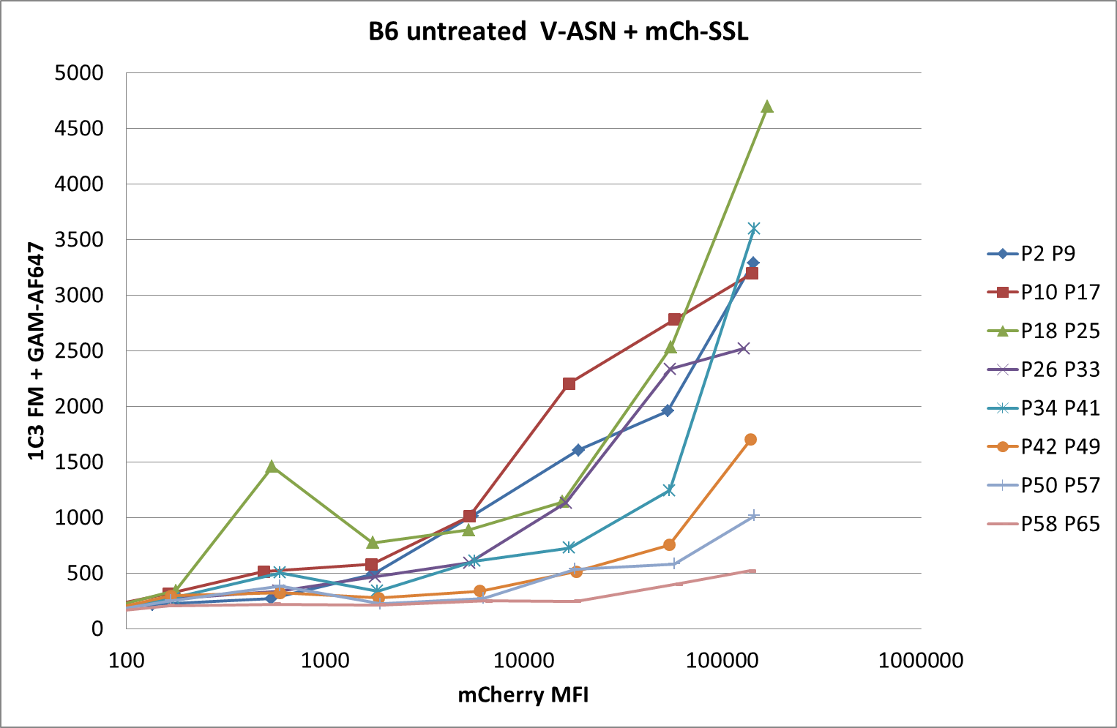
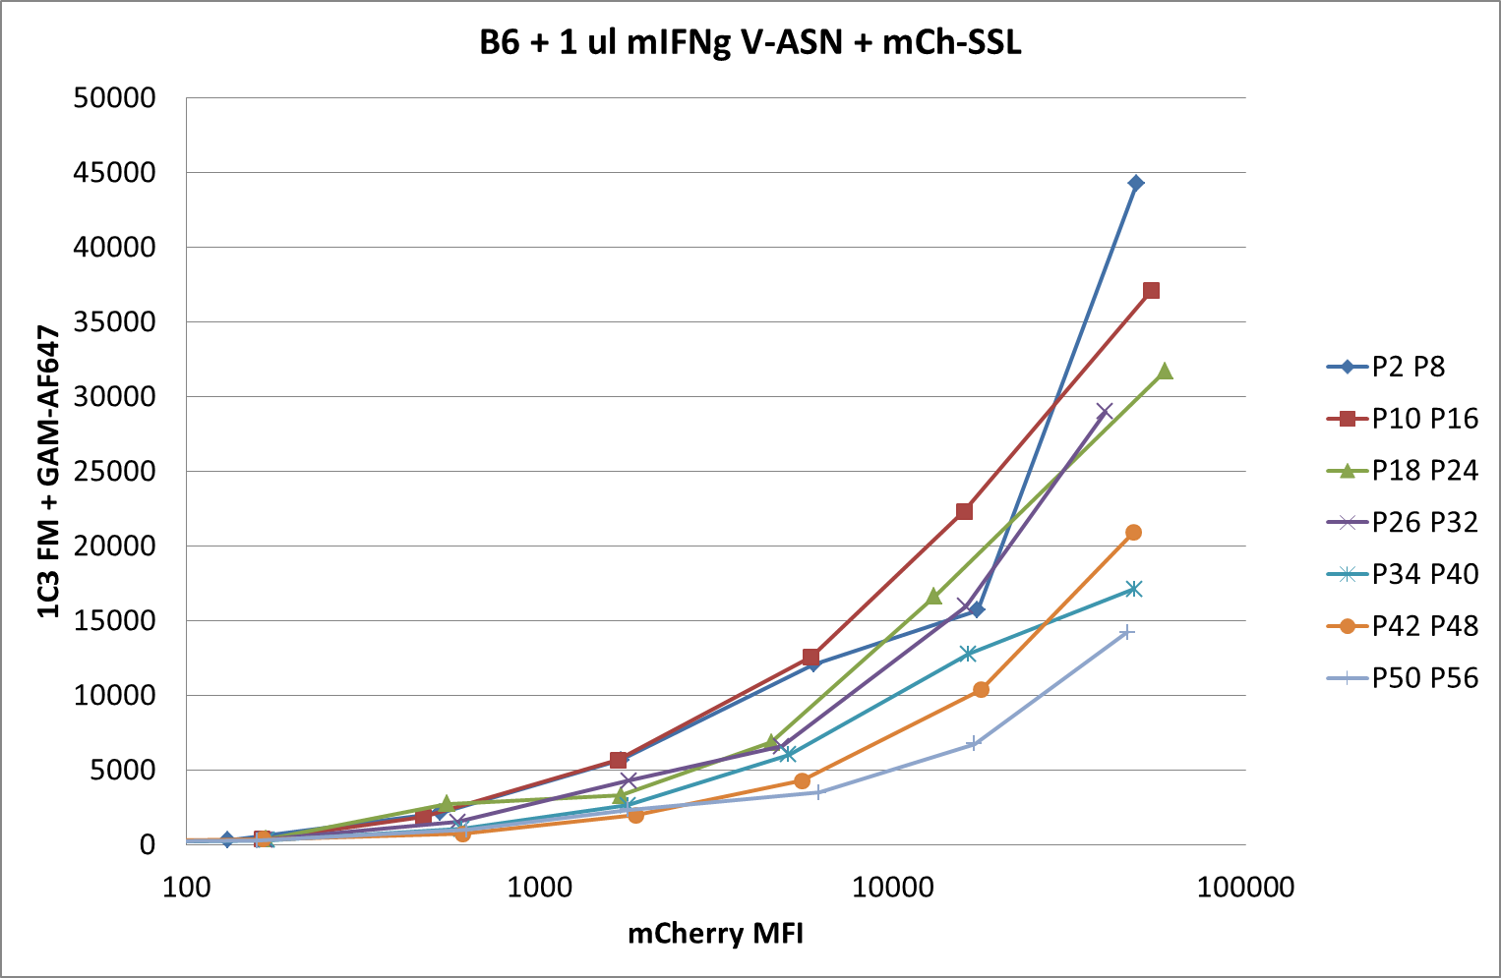
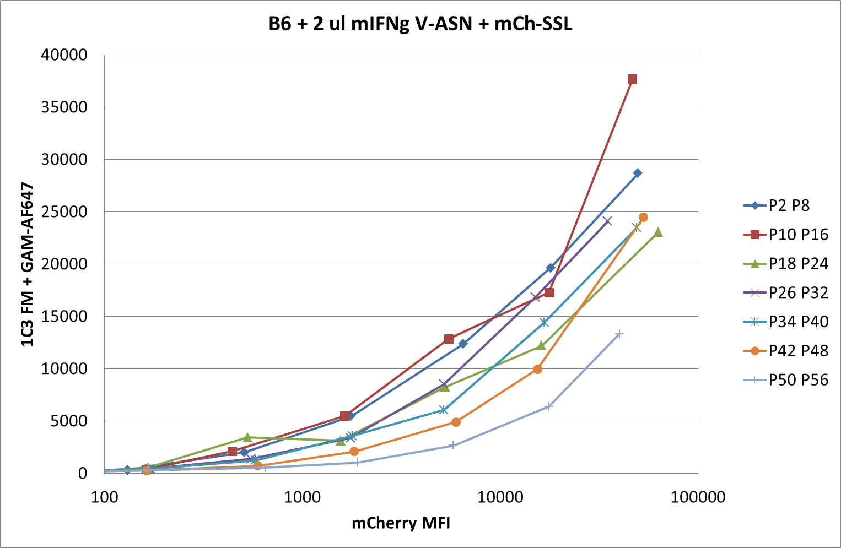
150520 pMHC competition
B6 wt fibroblasts +/- mIFNg
Notes:
Same with V-ASN instead of LSL

Slide 22
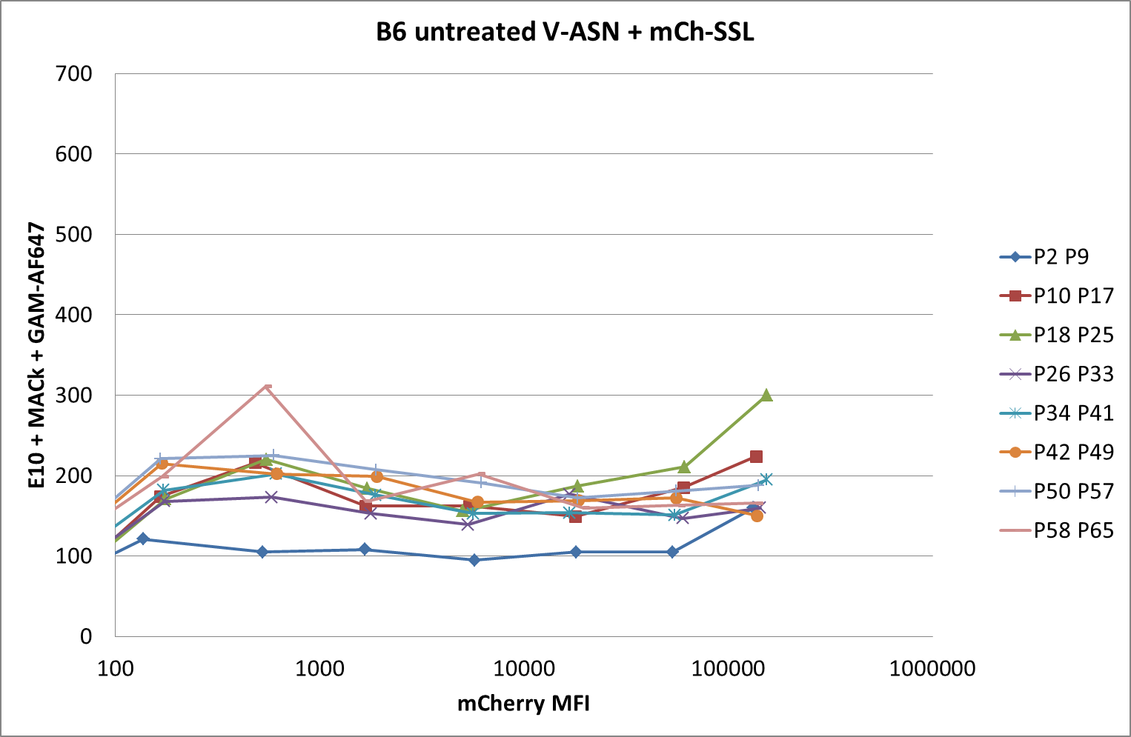
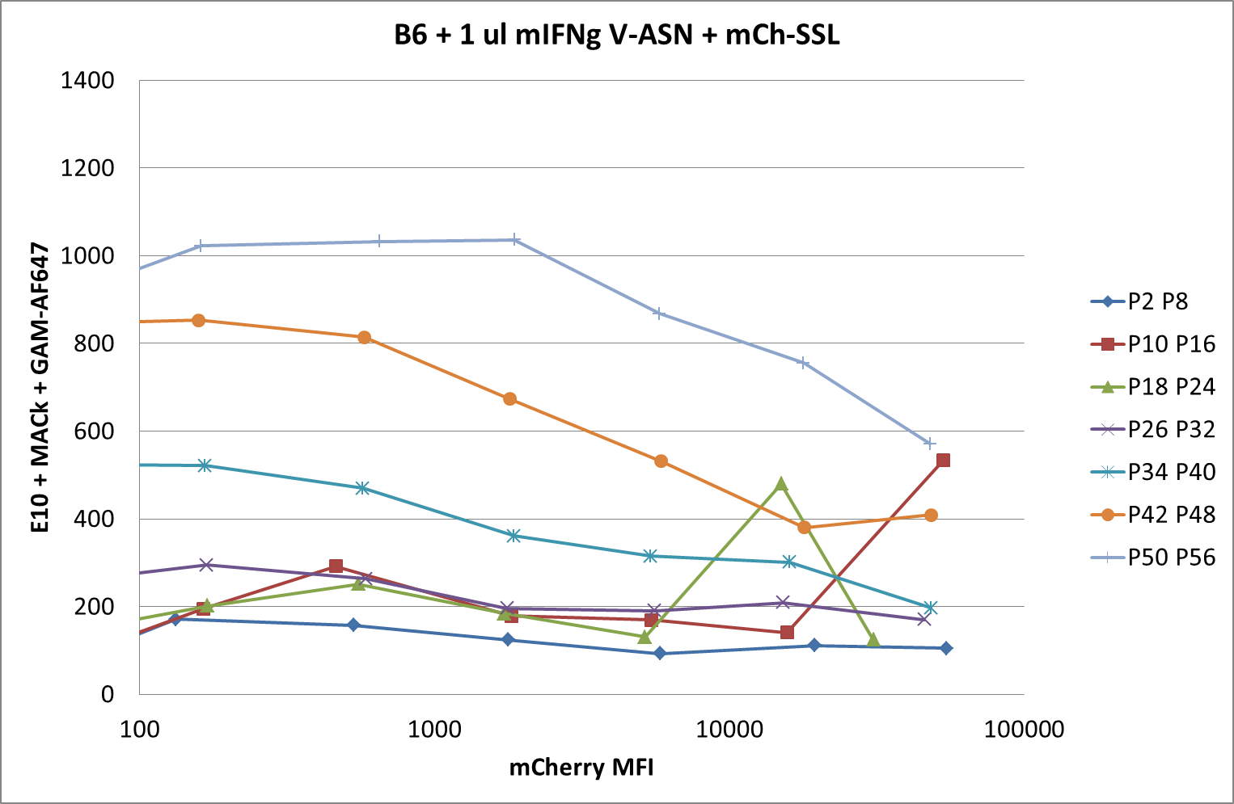
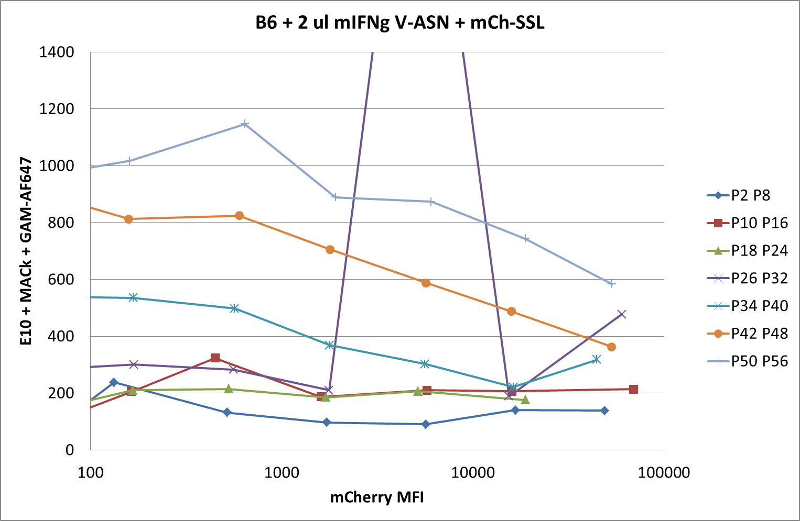
150520 pMHC competition
B6 wt fibroblasts +/- mIFNg
Notes:
ASN nicely detected in the presence of IFNg

Slide 23
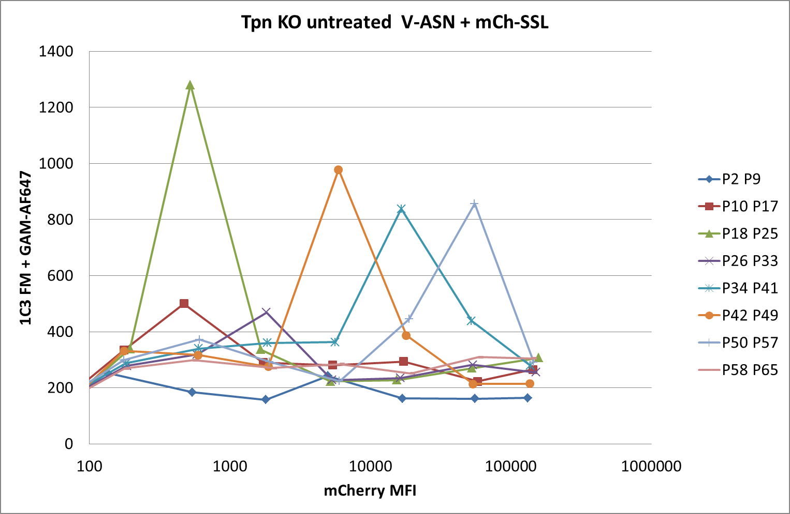
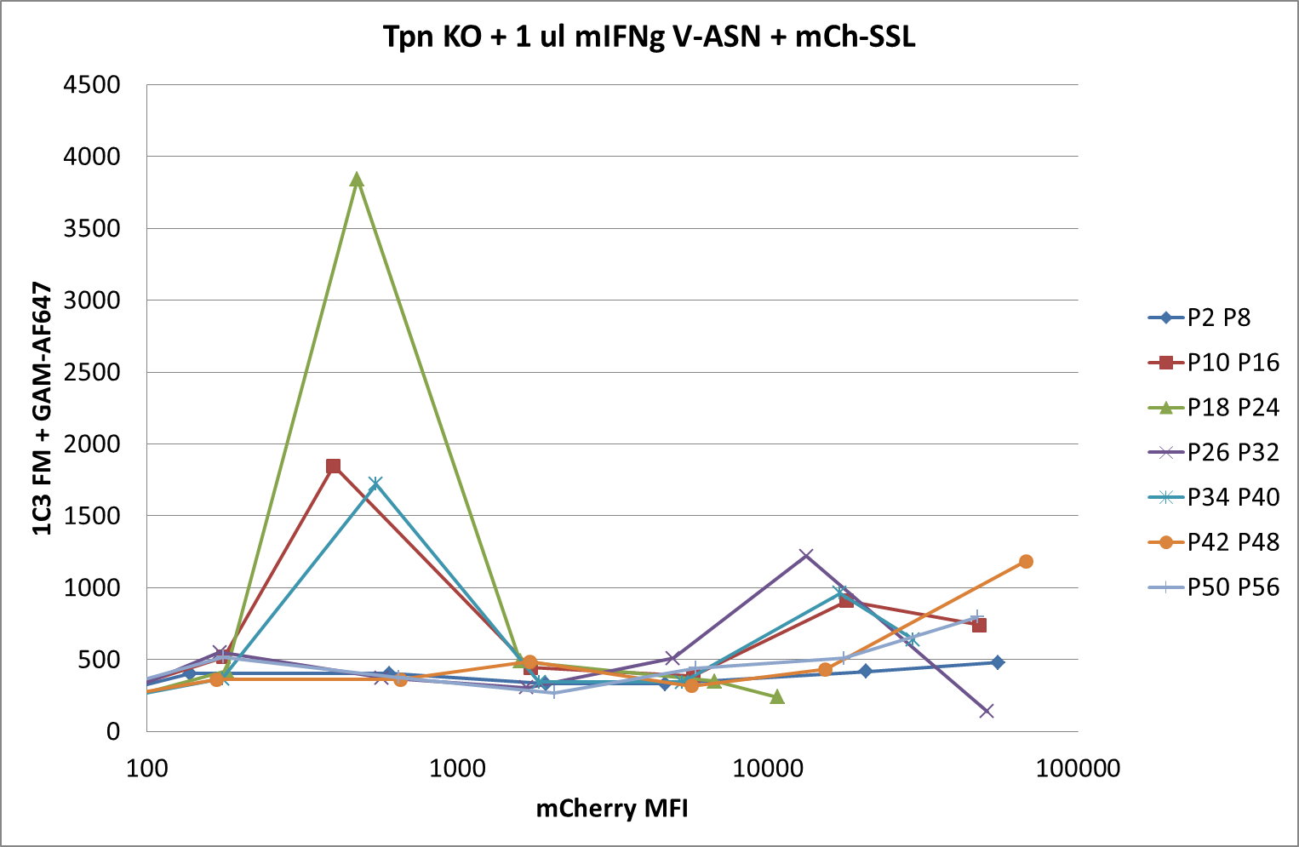

150520 pMHC competition
Tpn KO fibroblasts +/- mIFNg
Notes:
Only BG

Slide 24



150520 pMHC competition
Tpn KO fibroblasts +/- mIFNg
Notes:
Only BG

Slide 25



150520 pMHC competition
E°Tpn° fibroblasts +/- mIFNg
Notes:
Some SSL detected but not as nice as in previous experiment

Slide 26



150520 pMHC competition
E°Tpn° fibroblasts +/- mIFNg
Notes:
ASN not detected

